Slide 1
Chapter 3.3: Support Vector Machine II

Slide 2
Outline
Support vector machine model
Constrained optimization
Soft margin
Kernel methods

Slide 3
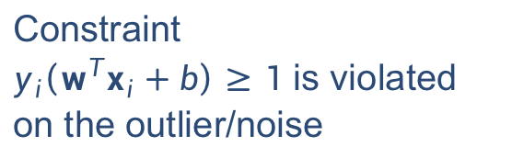
Non-linearly separable case
What if training data not linearly separable due to noise or outliers?
Constraint
$y_{i}\left(w^{T}x_{i}+b\right)≥1$ is violated on the outlier/noise

Slide 4
Linearly separable with small margin
Suppose we add an outlier which results in a classifier with a much smaller margin.

Slide 5
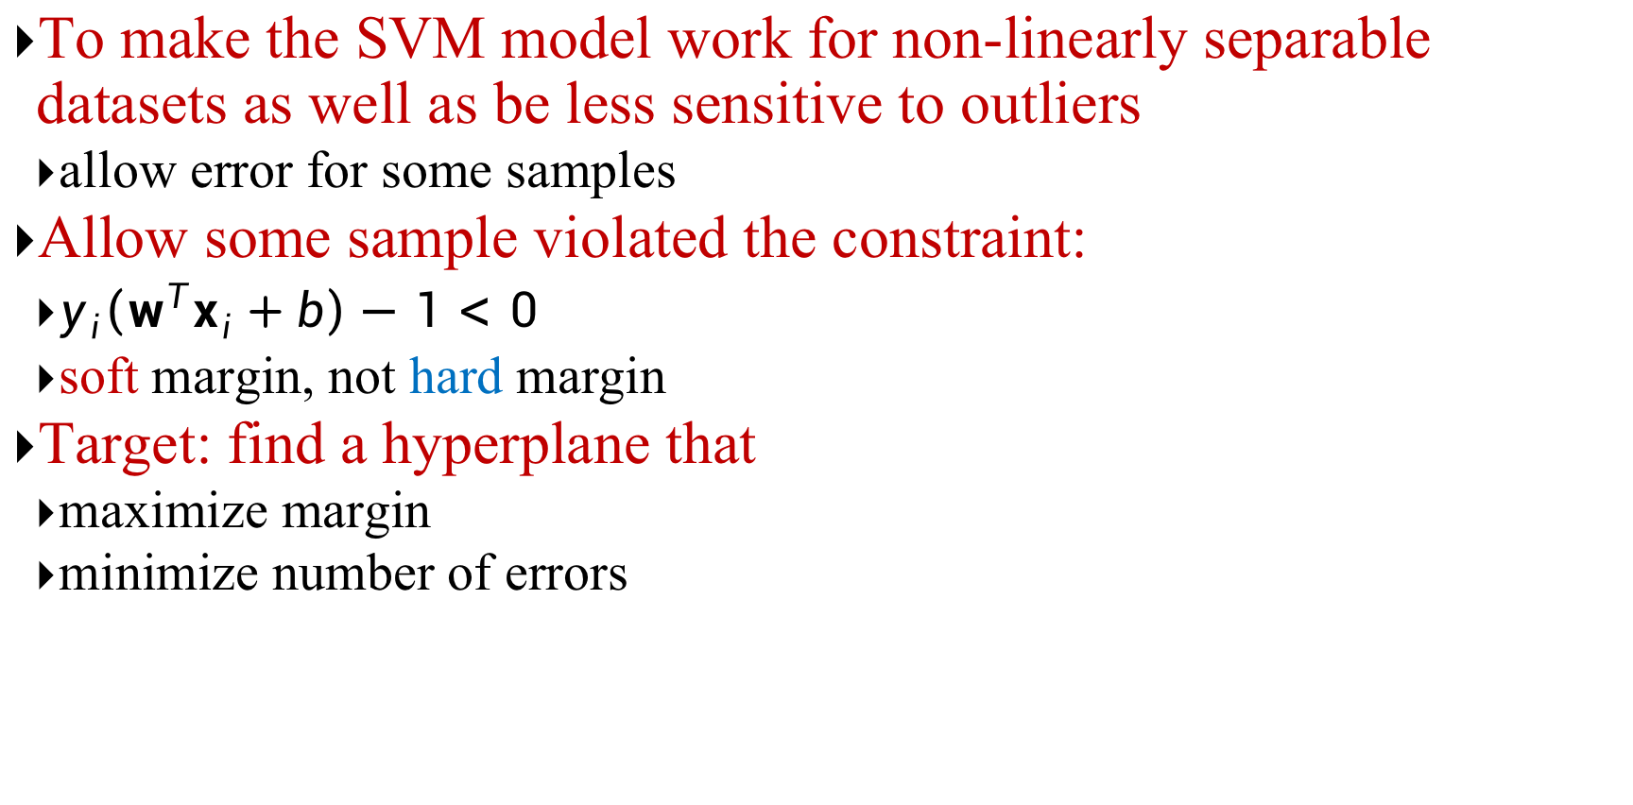
Soft Margin
To make the SVM model work for non-linearly separable datasets as well as be less sensitive to outliers
allow error for some samples
Allow some sample violated the constraint:
$y_{i}\left(w^{T}x_{i}+b\right)−1<0$
soft margin, not hard margin
Target: find a hyperplane that
maximize margin
minimize number of errors

Slide 6
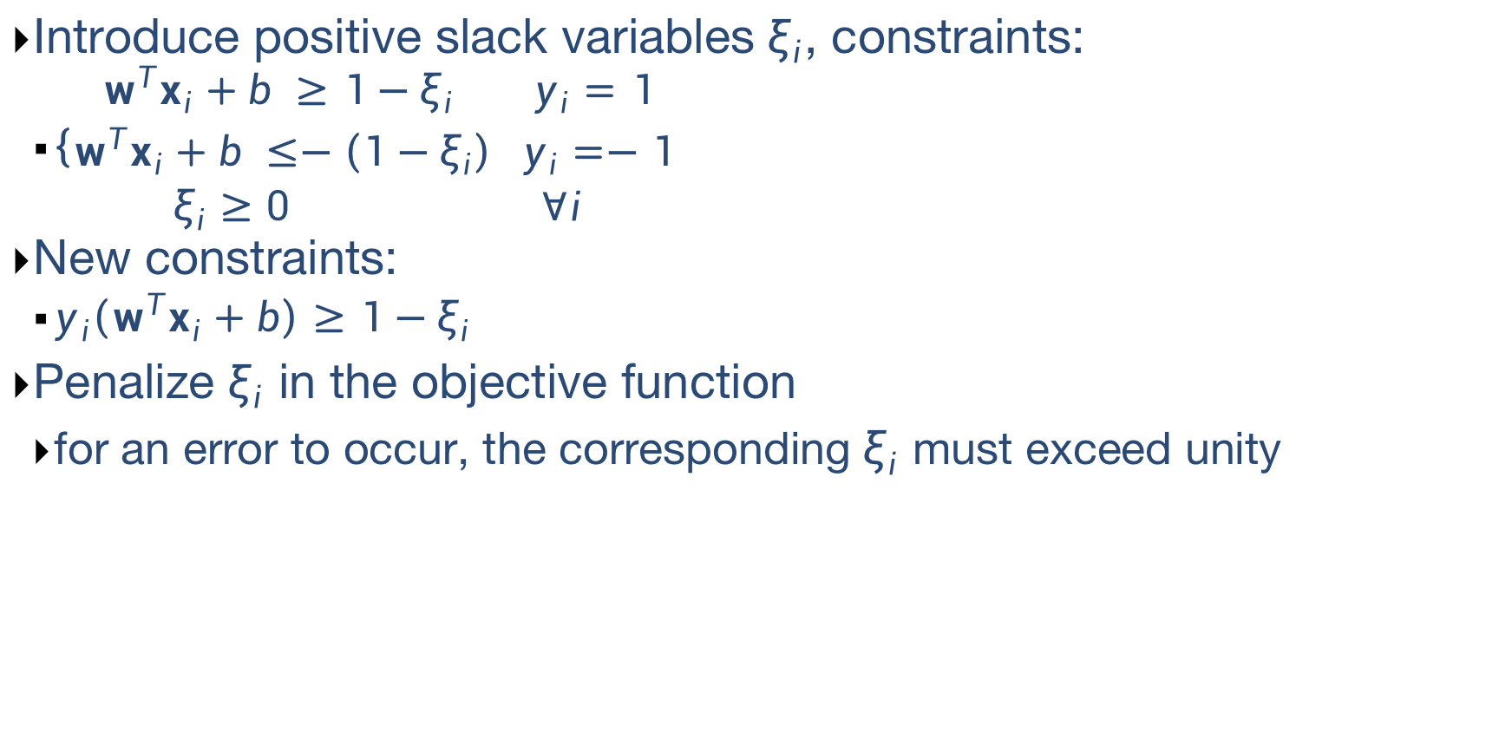
Soft Margin
Introduce positive slack variables $ξ_{i}$, constraints:
$\left\{\begin{aligned}w^{T}x_{i}+b ≥1−ξ_{i} y_{i}=1 \\ w^{T}x_{i}+b ≤−\left(1−ξ_{i}\right) y_{i}=−1 \\ ξ_{i}≥0 ∀i\end{aligned}\right.$
New constraints:
$y_{i}\left(w^{T}x_{i}+b\right)≥1−ξ_{i}$
Penalize $ξ_{i}$ in the objective function
for an error to occur, the corresponding $ξ_{i}$ must exceed unity

Slide 7
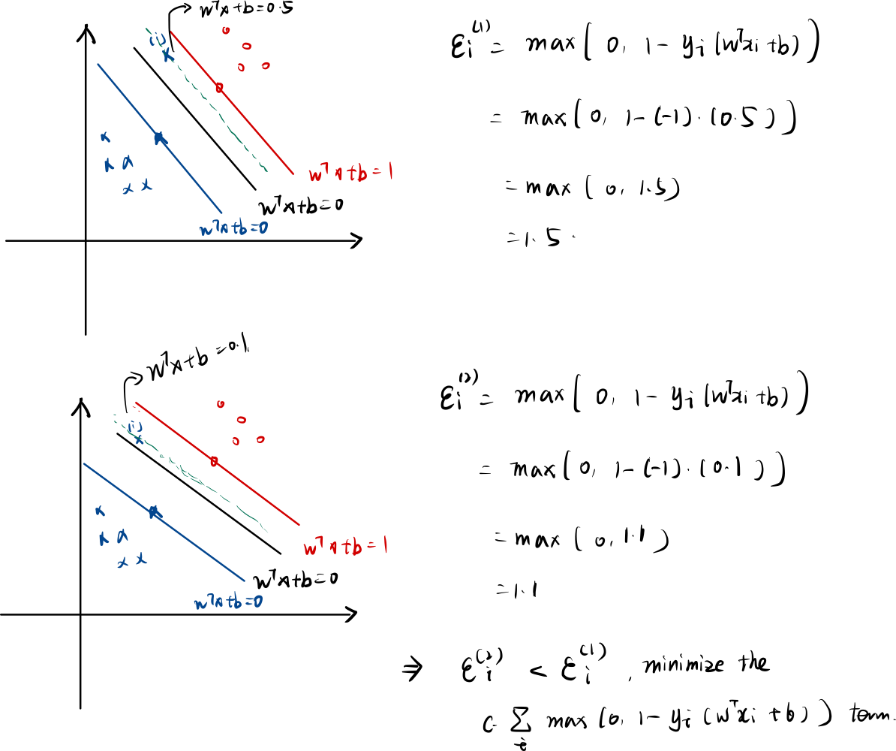
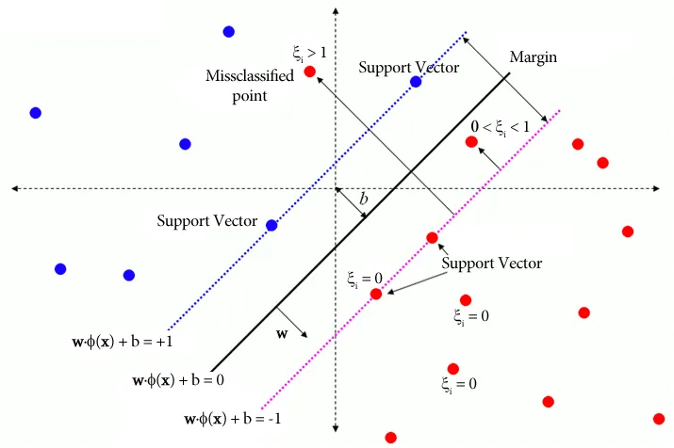
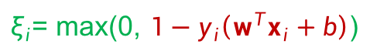
Optimization problem with soft margin
$ξ_{i}$= max(0, $1−y_{i}\left(w^{T}x_{i}+b\right)$)
Notes:
Another view of SVM: minimize hinge(1-y_i(wx+b)) + lamda ||w||2
Hinge loss l_h(z) = { z for z>0; 0 for z<0

Slide 8
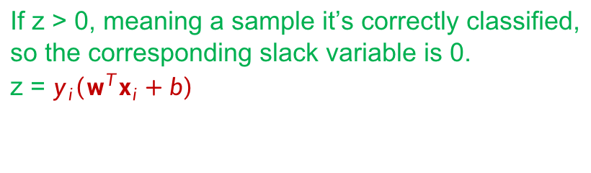
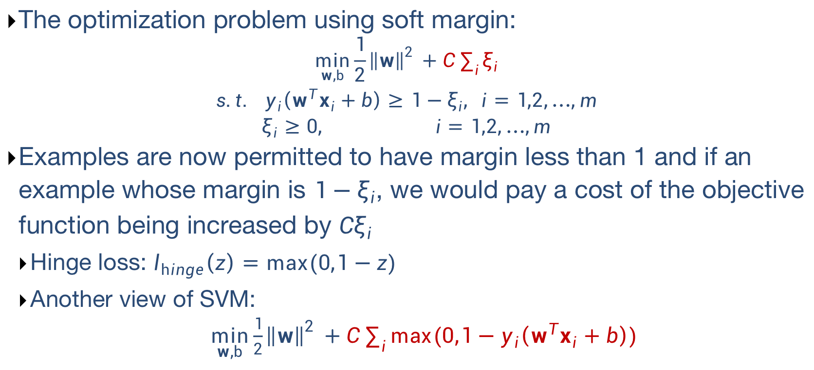
Optimization problem with soft margin
The optimization problem using soft margin:
$${\min_{w,b}{\frac{1}{2}{\left\|w\right\|}^{2}} \text{+} C\sum_{i}{ξ_{i}} \atop \begin{aligned}s.t. y_{i}\left(w^{T}x_{i}+b\right)≥1−ξ_{i}, i=1,2,…,m \\ ξ_{i}≥0, i=1,2,…,m\end{aligned}}$$
Examples are now permitted to have margin less than 1 and if an example whose margin is $1−ξ_{i}$, we would pay a cost of the objective function being increased by $Cξ_{i}$
Hinge loss: $l_{hinge}\left(z\right)=max⁡(0,1−z)$
Another view of SVM:
$\min_{w,b}{\frac{1}{2}{\left\|w\right\|}^{2}}\text{ +} C\sum_{i}{max⁡(0,1−y_{i}\left(w^{T}x_{i}+b\right))}$
If z > 0, meaning a sample it’s correctly classified,
so the corresponding slack variable is 0.
z = $y_{i}\left(w^{T}x_{i}+b\right)$
write the 2 constraints
into the objective function:
Notes:
Another view of SVM: minimize hinge(1-y_i(wx+b)) + lamda ||w||2
Hinge loss l_h(z) = { z for z>0; 0 for z<0

Slide 9
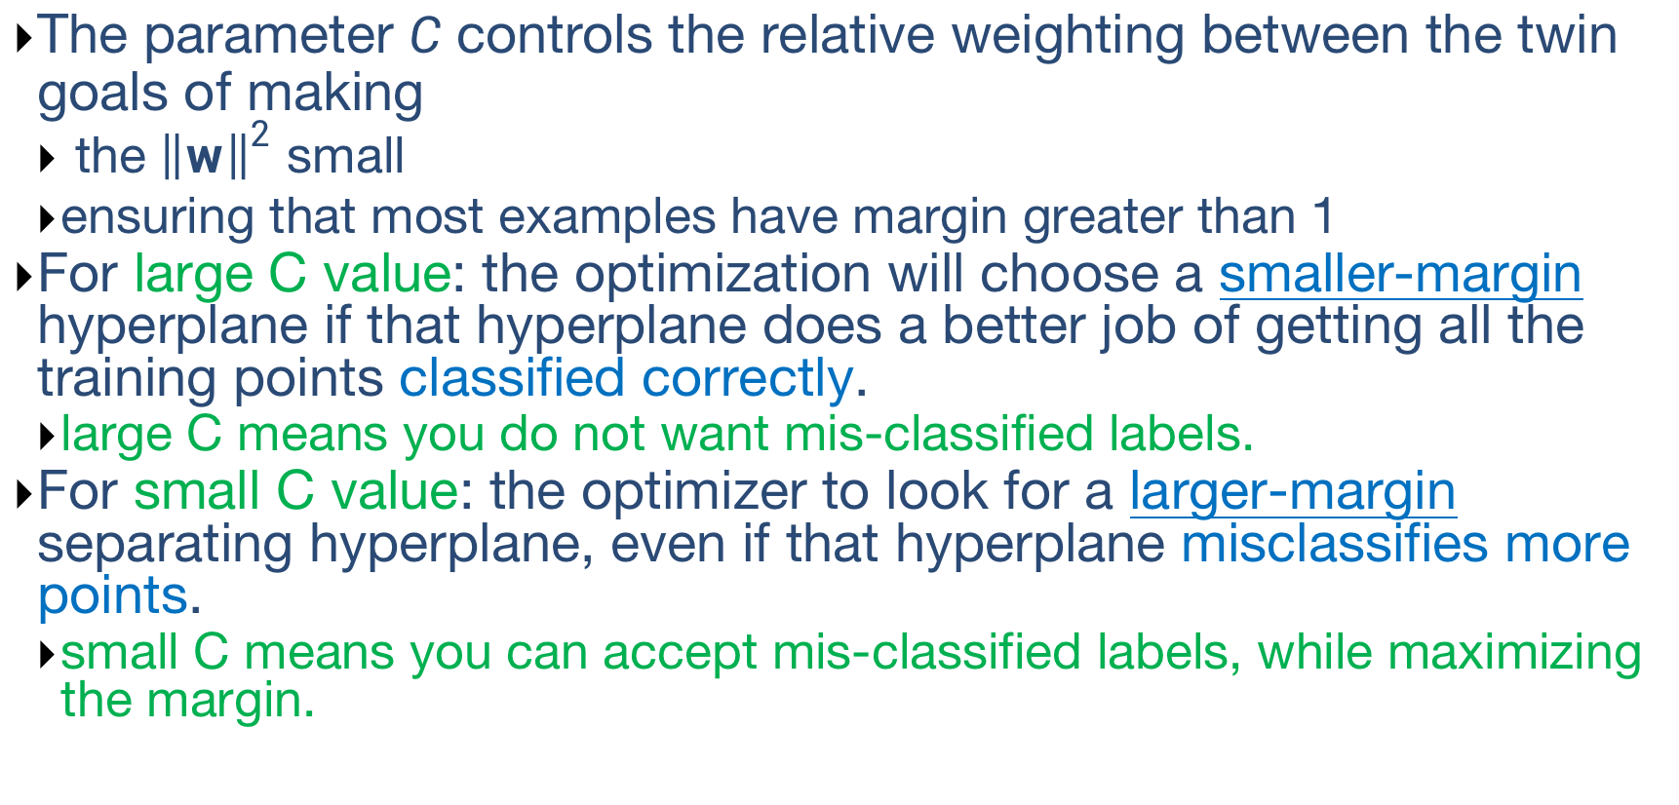
Optimization problem with soft margin
The parameter $C$ controls the relative weighting between the twin goals of making
the ${\left\|w\right\|}^{2}$ small
ensuring that most examples have margin greater than 1
For large C value: the optimization will choose a smaller-margin hyperplane if that hyperplane does a better job of getting all the training points classified correctly.
large C means you do not want mis-classified labels.
For small C value: the optimizer to look for a larger-margin separating hyperplane, even if that hyperplane misclassifies more points.
small C means you can accept mis-classified labels, while maximizing the margin.
Notes:
If C is large, the optimization strongly penalizes any misclassified point. Thus the margin is small.

Slide 10
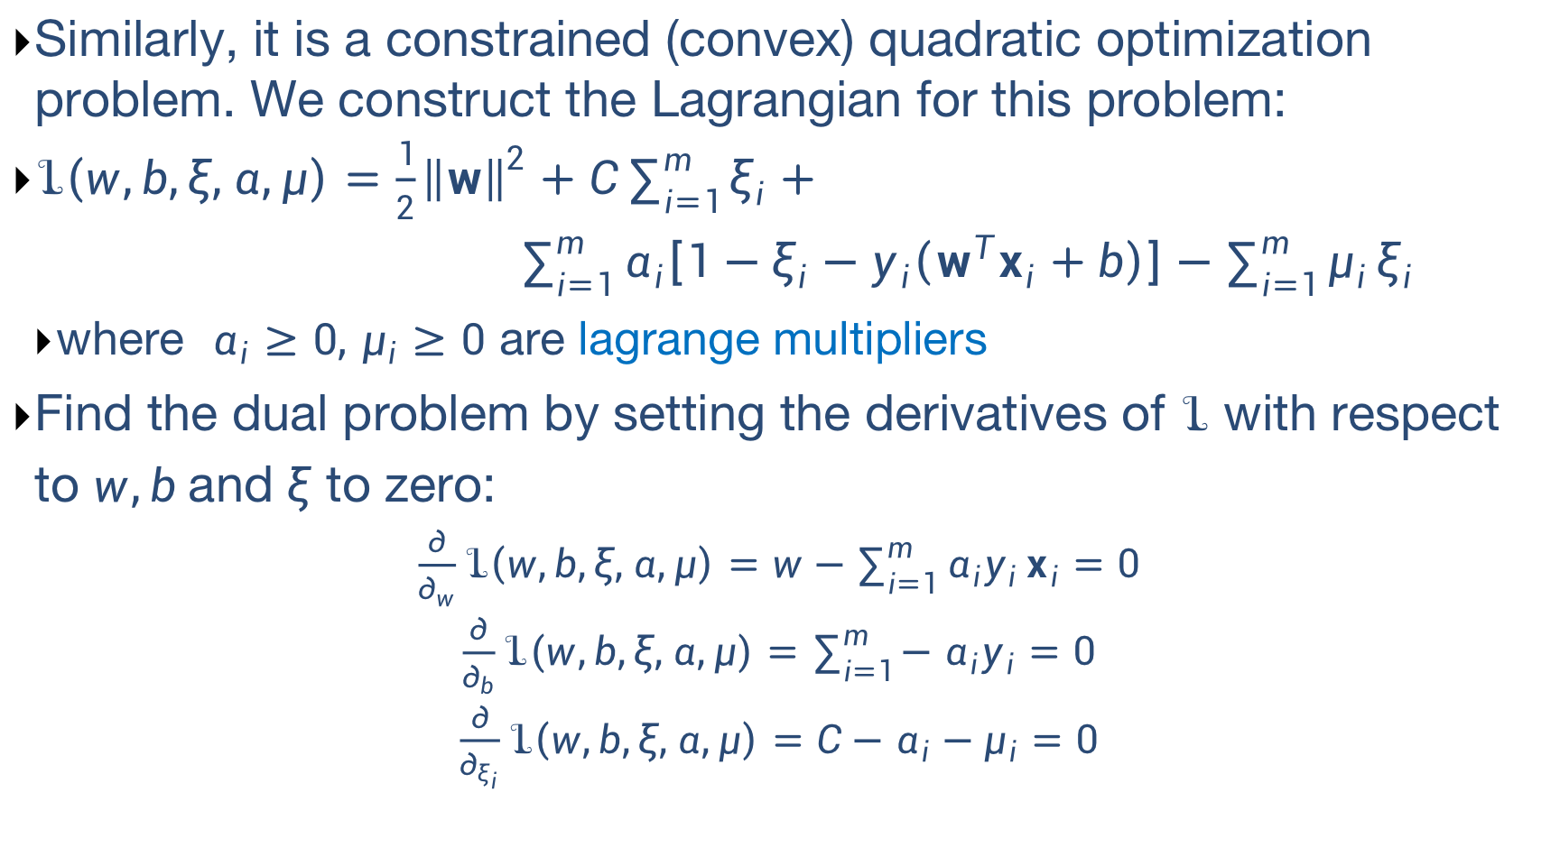
Optimization problem with soft margin (optional)
Similarly, it is a constrained (convex) quadratic optimization problem. We construct the Lagrangian for this problem:
$ℒ\left(w,b,ξ,α,μ\right)=\frac{1}{2}{\left\|w\right\|}^{2}+C\sum_{i=1}^{m}{ξ_{i}}+$
$\sum_{i=1}^{m}{α_{i}\left[1−ξ_{i}−y_{i}\left(w^{T}x_{i}+b\right)\right]}−\sum_{i=1}^{m}{μ_{i}}ξ_{i}$
where $α_{i}≥0,$ $μ_{i}≥0$ are lagrange multipliers
Find the dual problem by setting the derivatives of $ℒ$ with respect to $w,b$and $ξ$ to zero:
$\frac{∂}{∂_{w}}ℒ\left(w,b,ξ,α,μ\right)=w−\sum_{i=1}^{m}{α_{i}y_{i}}x_{i}=0$
$\frac{∂}{∂_{b}}ℒ\left(w,b,ξ,α,μ\right)=\sum_{i=1}^{m}{−α_{i}y_{i}}=0$
$\frac{∂}{∂_{ξ_{i}}}ℒ\left(w,b,ξ,α,μ\right)=C−α_{i}−μ_{i}=0$

Slide 11
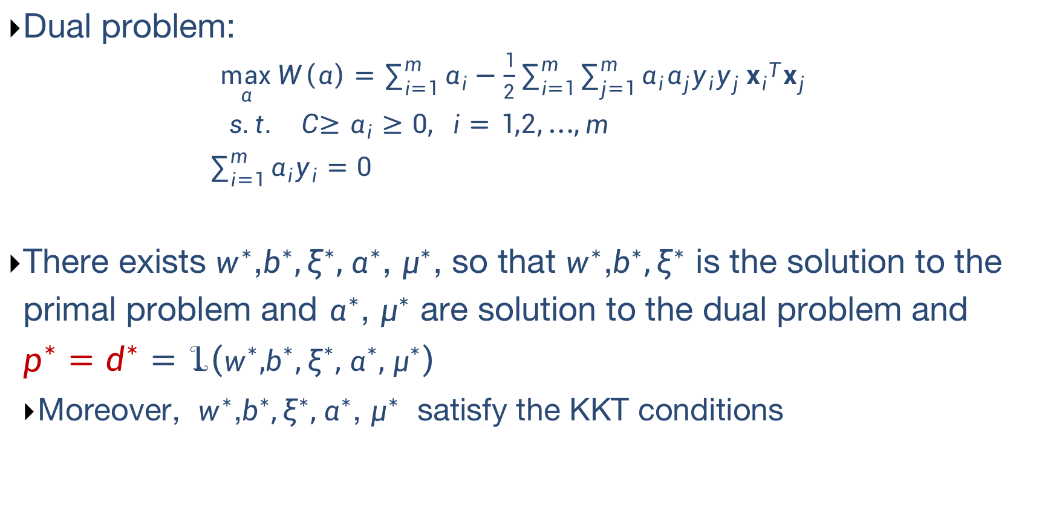
Optimization problem with soft margin (optional)
Dual problem:
$\max_{α}{W\left(α\right)=\sum_{i=1}^{m}{α_{i}}−\frac{1}{2}\sum_{i=1}^{m}{\sum_{j=1}^{m}{α_{i}α_{j}y_{i}y_{j}}}{x_{i}}^{T}x_{j}}$
$$s.t. C{≥α}_{i}≥0, i=1,2,…,m$$
$\sum_{i=1}^{m}{α_{i}y_{i}}=0$
There exists $w^{∗}$,$b^{∗},ξ^{∗},α^{∗}$, $μ^{∗}$, so that $w^{∗}$,$b^{∗},ξ^{∗}$ is the solution to the primal problem and $α^{∗}$, $μ^{∗}$ are solution to the dual problem and $p^{∗}=d^{∗}=ℒ\left(w^{∗}\text{,}b^{∗},ξ^{∗},α^{∗}\text{, }μ^{∗}\right)$
Moreover, $w^{∗}$,$b^{∗},ξ^{∗},α^{∗}$, $μ^{∗}$ satisfy the KKT conditions
Notes:
Completeness slackness (互补松弛条件) $α_{i}^{∗}(1−ξ_{i}−y_{i}\left(w^{T}x_{i}+b\right))=0$
Primal feasibility
Dual feasibility
Completeness slackness

Slide 12
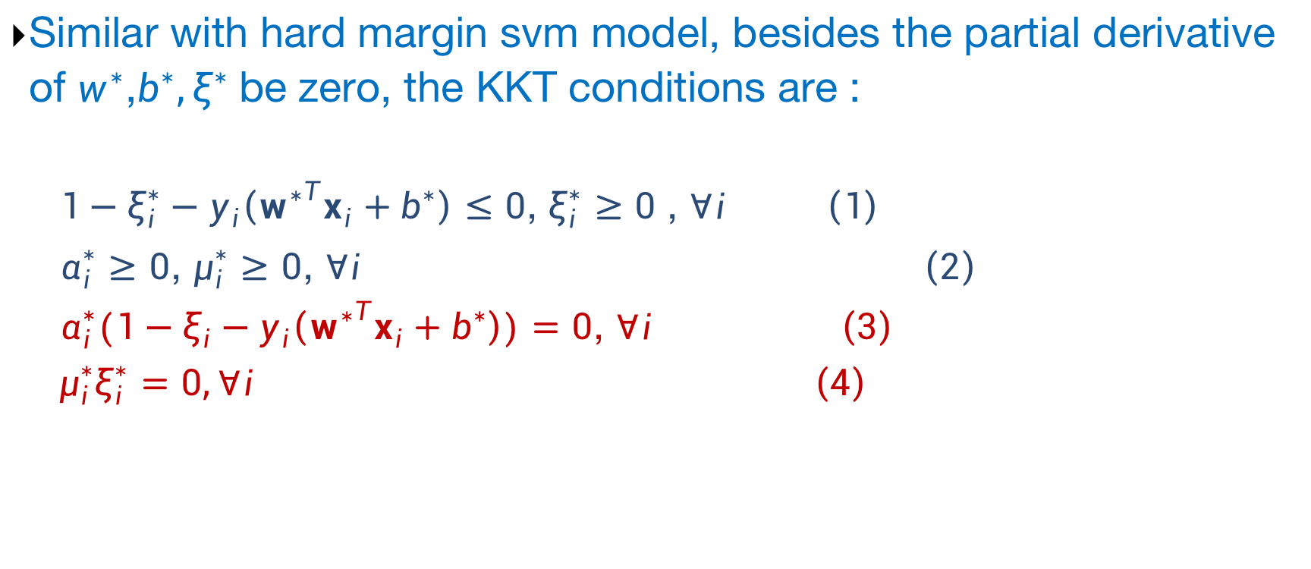
Optimization problem with soft margin (optional)
Similar with hard margin svm model, besides the partial derivative of $w^{∗}$,$b^{∗},ξ^{∗}$be zero, the KKT conditions are :
$1−ξ_{i}^{∗}−y_{i}\left({w^{∗}}^{T}x_{i}+b^{∗}\right)≤0$, $ξ_{i}^{∗}≥0$ , $∀i$ $\left(1\right)$
$α_{i}^{∗}≥0$, $μ_{i}^{∗}≥0$, $∀i$ $\left(2\right)$
$α_{i}^{∗}(1−ξ_{i}−y_{i}\left({w^{∗}}^{T}x_{i}+b^{∗}\right))=0$, $∀i$ $\left(3\right)$
$$μ_{i}^{∗}ξ_{i}^{∗}=0,∀i \left(4\right)$$
Notes:
Completeness slackness (互补松弛条件) $α_{i}^{∗}(1−ξ_{i}−y_{i}\left(w^{T}x_{i}+b\right))=0$, $μ_{i}^{∗}ξ_{i}^{∗}$=0
Primal feasibility
Dual feasibility

Slide 13
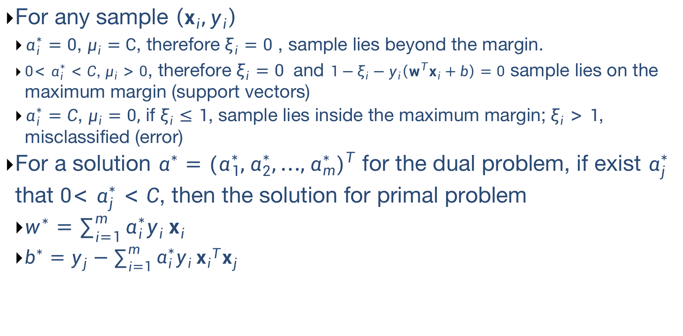
Soft Margin SVM
For any sample $\left(x_{i},y_{i}\right)$
$α_{i}^{∗}=0$, $μ_{i}=C$, therefore $ξ_{i}=0$ , sample lies beyond the margin.
$0{<α}_{i}^{∗}<C$, $μ_{i}>0$, therefore $ξ_{i}=0$ and $1−ξ_{i}−y_{i}\left(w^{T}x_{i}+b\right)=0$ sample lies on the maximum margin (support vectors)
$α_{i}^{∗}=C$, $μ_{i}=0,$ if $ξ_{i}≤1$, sample lies inside the maximum margin; $ξ_{i}>1$, misclassified (error)
For a solution $α^{∗}={(α_{1}^{∗},α_{2}^{∗},…,α_{m}^{∗})}^{T}$ for the dual problem, if exist $α_{j}^{∗}$ that $0{<α}_{j}^{∗}<C$, then the solution for primal problem
$w^{∗}=\sum_{i=1}^{m}{α_{i}^{∗}y_{i}}x_{i}$
$b^{∗}=y_{j}−\sum_{i=1}^{m}{α_{i}^{∗}y_{i}}{x_{i}}^{T}x_{j}$

Slide 14



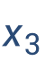
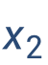

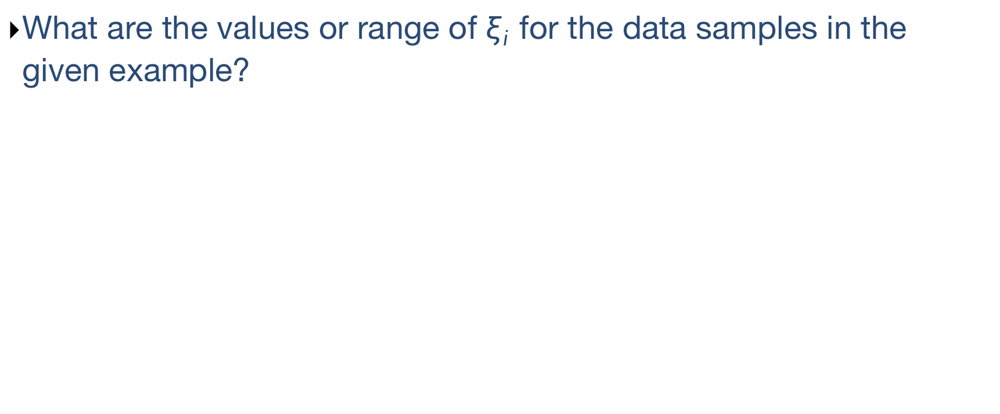
Soft Margin SVM
What are the values or range of $ξ_{i}$ for the data samples in the given example?
$$x_{5}$$
$$x_{6}$$
$$x_{1}$$
$$x_{4}$$
$$x_{3}$$
$$x_{2}$$
Notes:
Delta: 0,1, (0,1), 0, >1,>1

Slide 15
Nonlinear SVM
What if training data not linearly separable?
Naïve: find non-linear decision surface
Not efficient
Feature transformation: map the original attributes into new feature space and apply linear model in the new space.

Slide 16
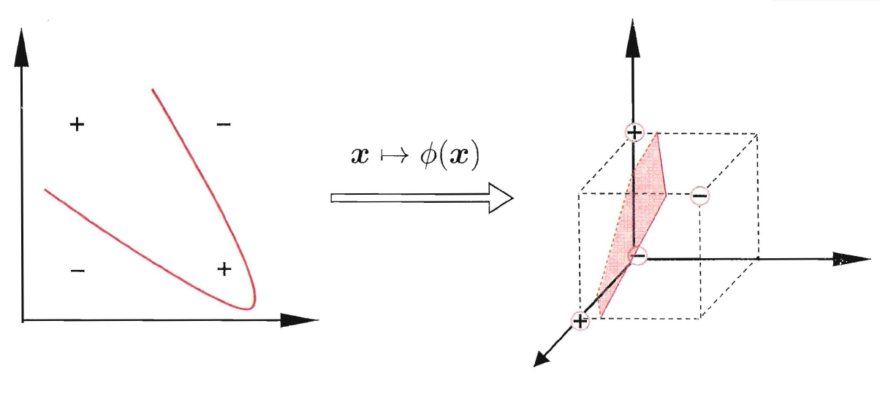
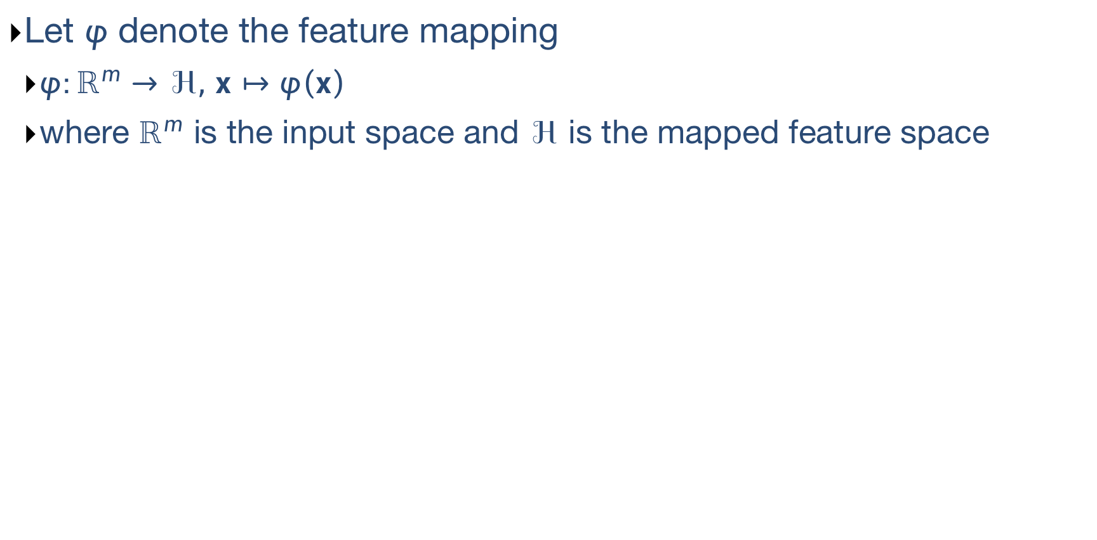
Feature Mapping
Let $φ$ denote the feature mapping
$φ:ℝ^{m}→ℋ,$ $x↦φ\left(x\right)$
where $ℝ^{m}$ is the input space and $ℋ$ is the mapped feature space

Slide 17
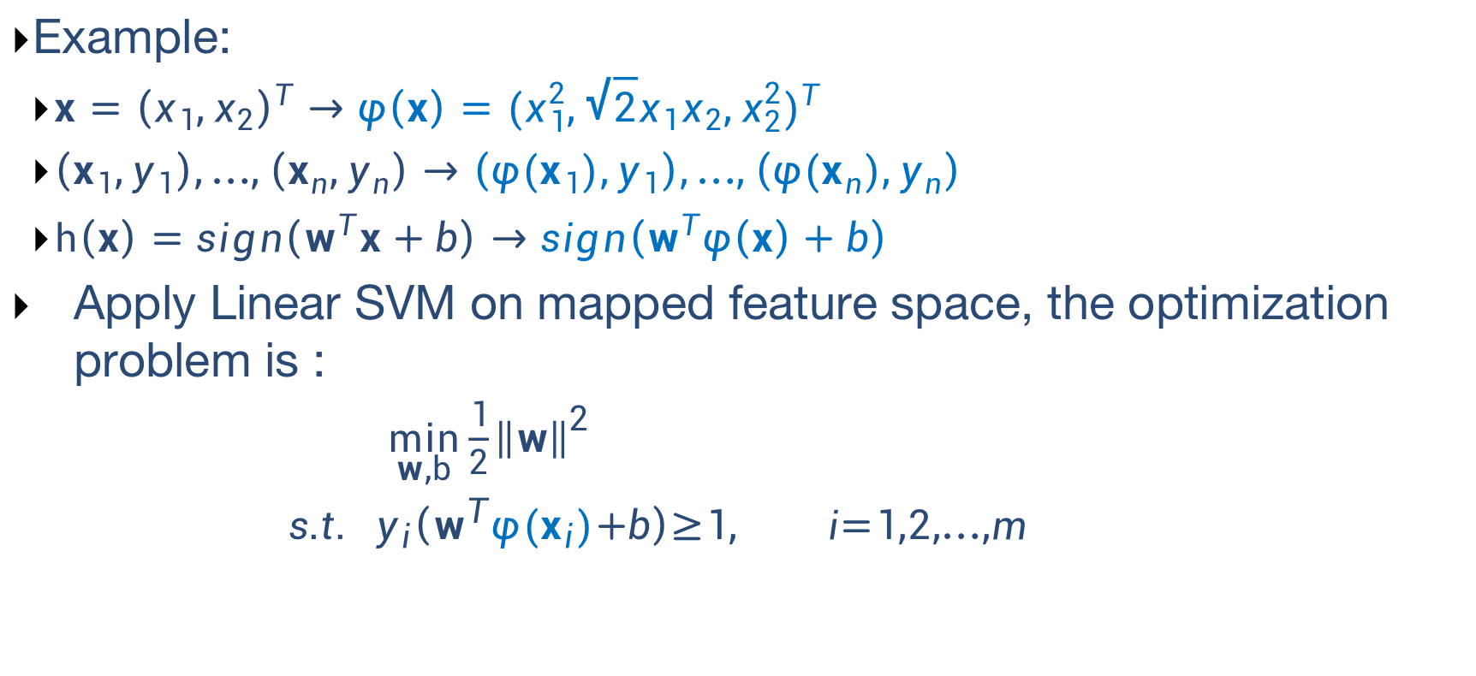
Feature Mapping
Example:
$x={\left(x_{1},x_{2}\right)}^{T}$ $→$ $φ\left(x\right)={(x_{1}^{2},\sqrt{2}x_{1}x_{2},x_{2}^{2})}^{T}$
$\left(x_{1},y_{1}\right),…,\left(x_{n},y_{n}\right)→$ $\left(φ(x_{1}),y_{1}\right),…,\left(φ(x_{n}),y_{n}\right)$
$h\left(x\right)=sign\left(w^{T}x+b\right)$ $→sign\left(w^{T}φ\left(x\right)+b\right)$
Apply Linear SVM on mapped feature space, the optimization problem is :
${\min_{w,b}{\frac{1}{2}{\left\|w\right\|}^{2}} \atop s.t. y_{i}\left(w^{T}{φ(x}_{i})+b\right)≥1, i=1,2,…,m }$

Slide 18
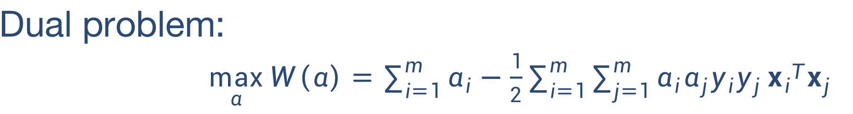
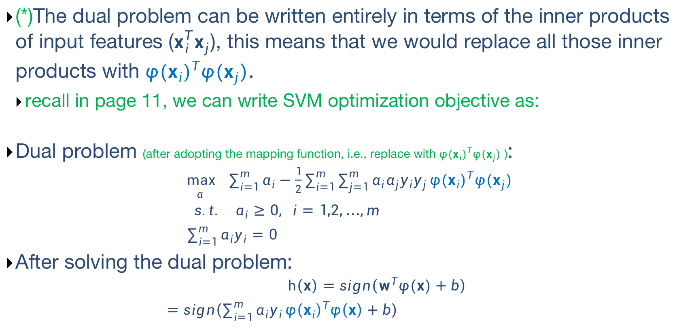
Feature Mapping
(*)The dual problem can be written entirely in terms of the inner products of input features ($x_{i}^{T}x_{j}$), this means that we would replace all those inner products with ${{φ(x}_{i})}^{T}φ(x_{j})$.
recall in page 11, we can write SVM optimization objective as:
Dual problem (after adopting the mapping function, i.e., replace with ${{φ(x}_{i})}^{T}φ(x_{j})$ ):
$\max_{α}{ \sum_{i=1}^{m}{α_{i}}−\frac{1}{2}\sum_{i=1}^{m}{\sum_{j=1}^{m}{α_{i}α_{j}y_{i}y_{j}}}{{φ(x}_{i})}^{T}φ(x_{j})}$
$$s.t. α_{i}≥0, i=1,2,…,m$$
$\sum_{i=1}^{m}{α_{i}y_{i}}=0$
After solving the dual problem:
$$h\left(x\right)=sign\left(w^{T}φ(x)+b\right)$$
$=sign\left(\sum_{i=1}^{m}{α_{i}y_{i}}{φ\left(x_{i}\right)}^{T}φ\left(x\right)+b\right)$

Slide 19
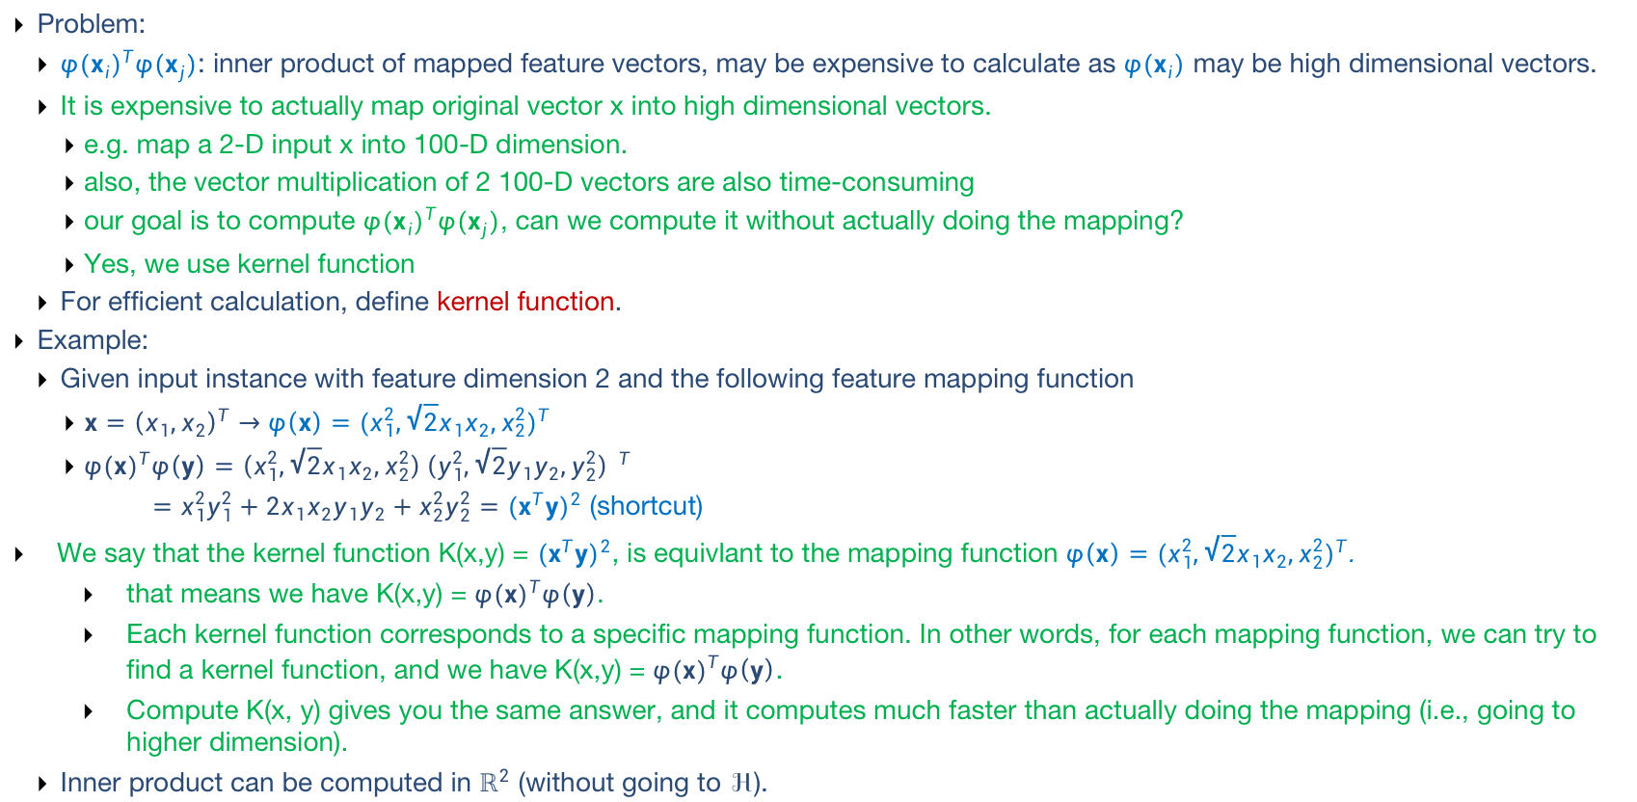
Feature Mapping
Problem:
${{φ(x}_{i})}^{T}φ(x_{j})$: inner product of mapped feature vectors, may be expensive to calculate as $φ(x_{i})$ may be high dimensional vectors.
It is expensive to actually map original vector x into high dimensional vectors.
e.g. map a 2-D input x into 100-D dimension.
also, the vector multiplication of 2 100-D vectors are also time-consuming
our goal is to compute ${{φ(x}_{i})}^{T}φ(x_{j})$, can we compute it without actually doing the mapping?
Yes, we use kernel function
For efficient calculation, define kernel function.
Example:
Given input instance with feature dimension 2 and the following feature mapping function
$x={\left(x_{1},x_{2}\right)}^{T}$ $→$ $φ\left(x\right)={(x_{1}^{2},\sqrt{2}x_{1}x_{2},x_{2}^{2})}^{T}$
${φ(x)}^{T}φ\left(y\right)=\left(x_{1}^{2},\sqrt{2}x_{1}x_{2},x_{2}^{2}\right){\left(y_{1}^{2},\sqrt{2}y_{1}y_{2},y_{2}^{2}\right) }^{T}$
$=x_{1}^{2}y_{1}^{2}+2x_{1}x_{2}y_{1}y_{2}+x_{2}^{2}y_{2}^{2}={(x^{T}y)}^{2}$ (shortcut)
We say that the kernel function K(x,y) = ${(x^{T}y)}^{2}$, is equivlant to the mapping function $φ\left(x\right)={(x_{1}^{2},\sqrt{2}x_{1}x_{2},x_{2}^{2})}^{T}$.
that means we have K(x,y) = ${φ(x)}^{T}φ\left(y\right)$.
Each kernel function corresponds to a specific mapping function. In other words, for each mapping function, we can try to find a kernel function, and we have K(x,y) = ${φ(x)}^{T}φ\left(y\right)$.
Compute K(x, y) gives you the same answer, and it computes much faster than actually doing the mapping (i.e., going to higher dimension).
Inner product can be computed in $ℝ^{2}$ (without going to $ℋ$).
Notes:
Feature mapping is not unique.

Slide 20
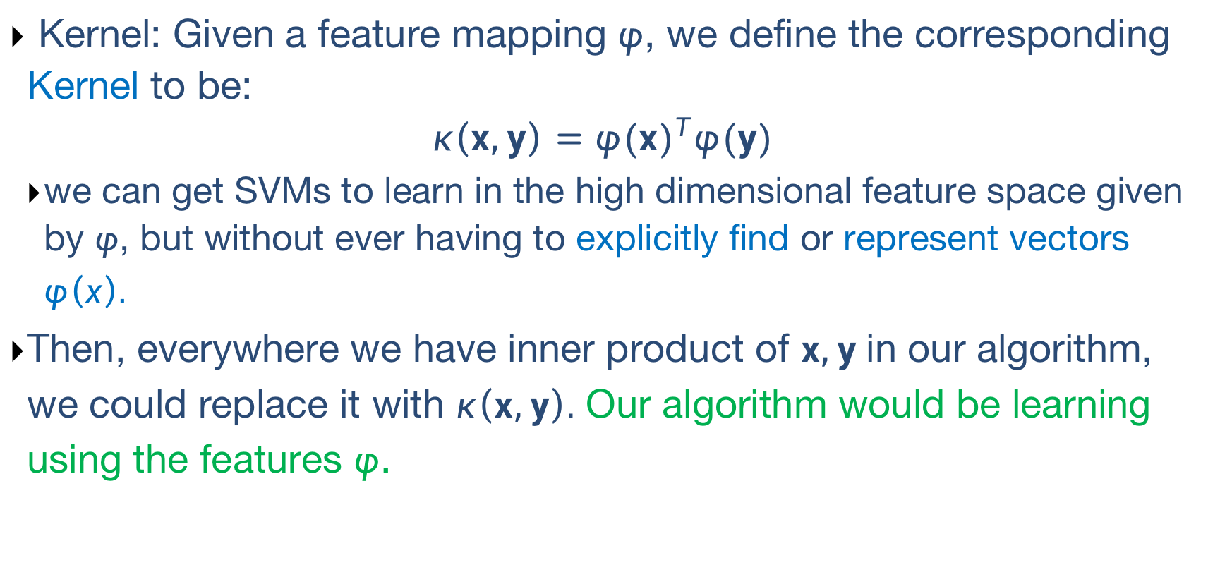
Kernel Functions
Kernel: Given a feature mapping $φ$, we define the corresponding Kernel to be:
$$κ\left(x,y\right)={φ(x)}^{T}φ(y)$$
we can get SVMs to learn in the high dimensional feature space given by $φ$, but without ever having to explicitly find or represent vectors $φ\left(x\right).$
Then, everywhere we have inner product of $x,y$in our algorithm, we could replace it with $κ\left(x,y\right).$ Our algorithm would be learning using the features $φ$.

Slide 21
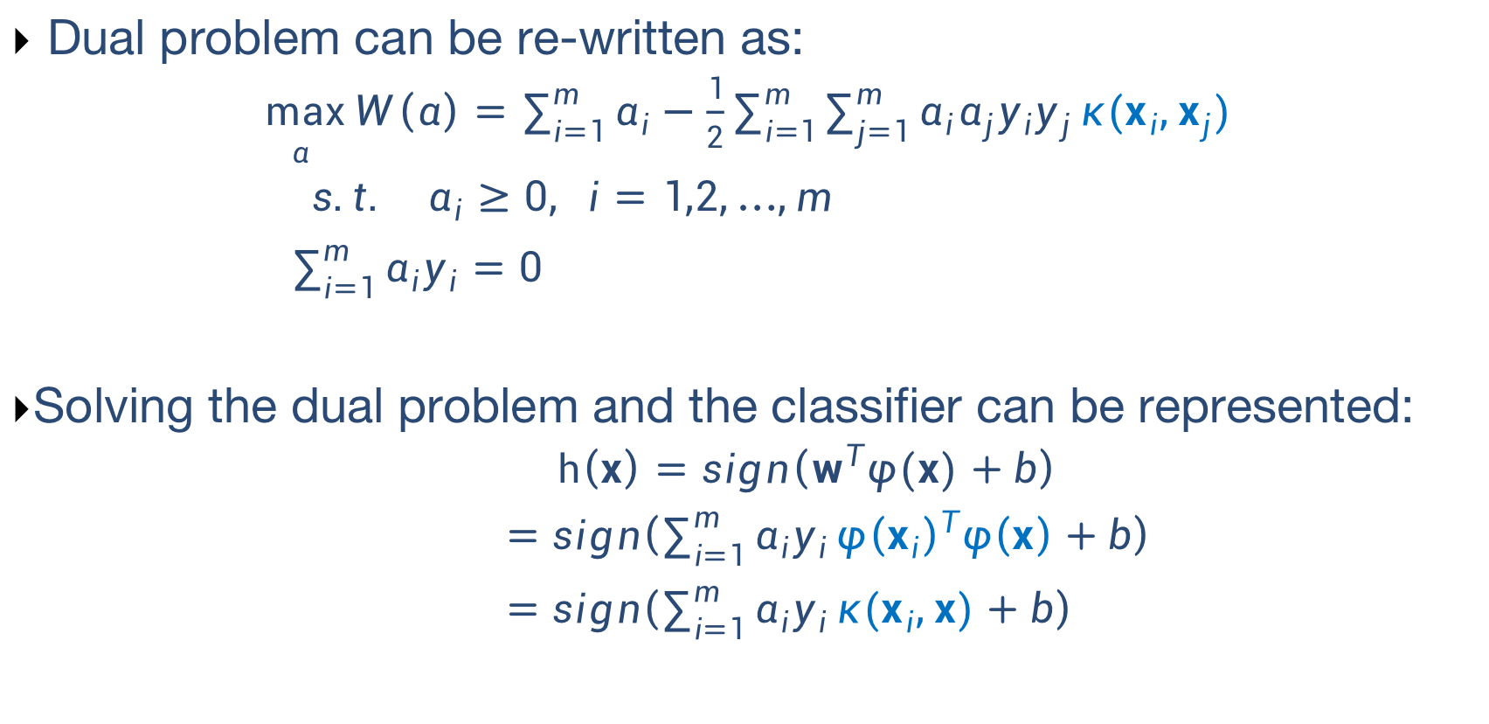
Kernel Functions
Dual problem can be re-written as:
$\max_{α}{W\left(α\right)=\sum_{i=1}^{m}{α_{i}}−\frac{1}{2}\sum_{i=1}^{m}{\sum_{j=1}^{m}{α_{i}α_{j}y_{i}y_{j}}κ(x_{i},x_{j})}}$
$$s.t. α_{i}≥0, i=1,2,…,m$$
$\sum_{i=1}^{m}{α_{i}y_{i}}=0$
Solving the dual problem and the classifier can be represented:
$$h\left(x\right)=sign\left(w^{T}φ(x)+b\right)$$
$=sign\left(\sum_{i=1}^{m}{α_{i}y_{i}}{φ\left(x_{i}\right)}^{T}φ\left(x\right)+b\right)$
$=sign\left(\sum_{i=1}^{m}{α_{i}y_{i}}κ(x_{i},x)+b\right)$

Slide 22
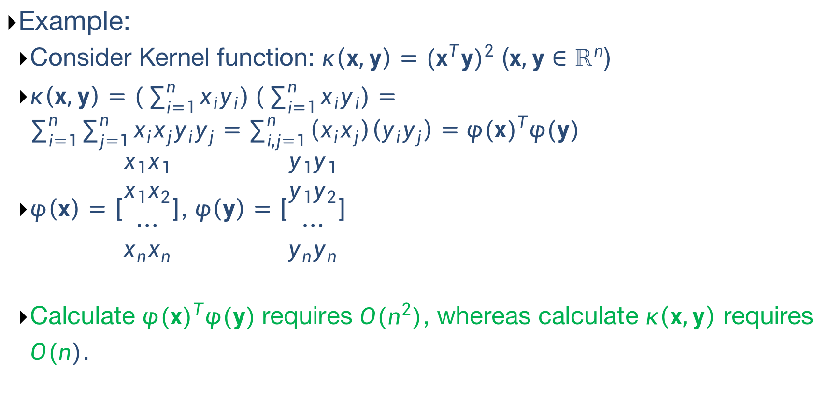
Kernel Functions - Examples
Example:
Consider Kernel function: $κ\left(x,y\right)={(x^{T}y)}^{2}$ ($x,y∈ℝ^{n}$)
$κ\left(x,y\right)=(\sum_{i=1}^{n}{x_{i}y_{i})}(\sum_{i=1}^{n}{x_{i}y_{i})}=\sum_{i=1}^{n}{\sum_{j=1}^{n}{x_{i}x_{j}y_{i}y_{j}=\sum_{i,j=1}^{n}{\left(x_{i}x_{j}\right)\left(y_{i}y_{j}\right)={φ(x)}^{T}φ(y) }}}$
$φ\left(x\right)=\left[\begin{aligned}x_{1}x_{1} \\ x_{1}x_{2} \\ … \\ x_{n}x_{n}\end{aligned}\right]$, $φ\left(y\right)=\left[\begin{aligned}y_{1}y_{1} \\ y_{1}y_{2} \\ … \\ y_{n}y_{n}\end{aligned}\right]$
Calculate ${φ(x)}^{T}φ(y)$requires $O(n^{2})$, whereas calculate $κ\left(x,y\right)$ requires $O(n)$.

Slide 23
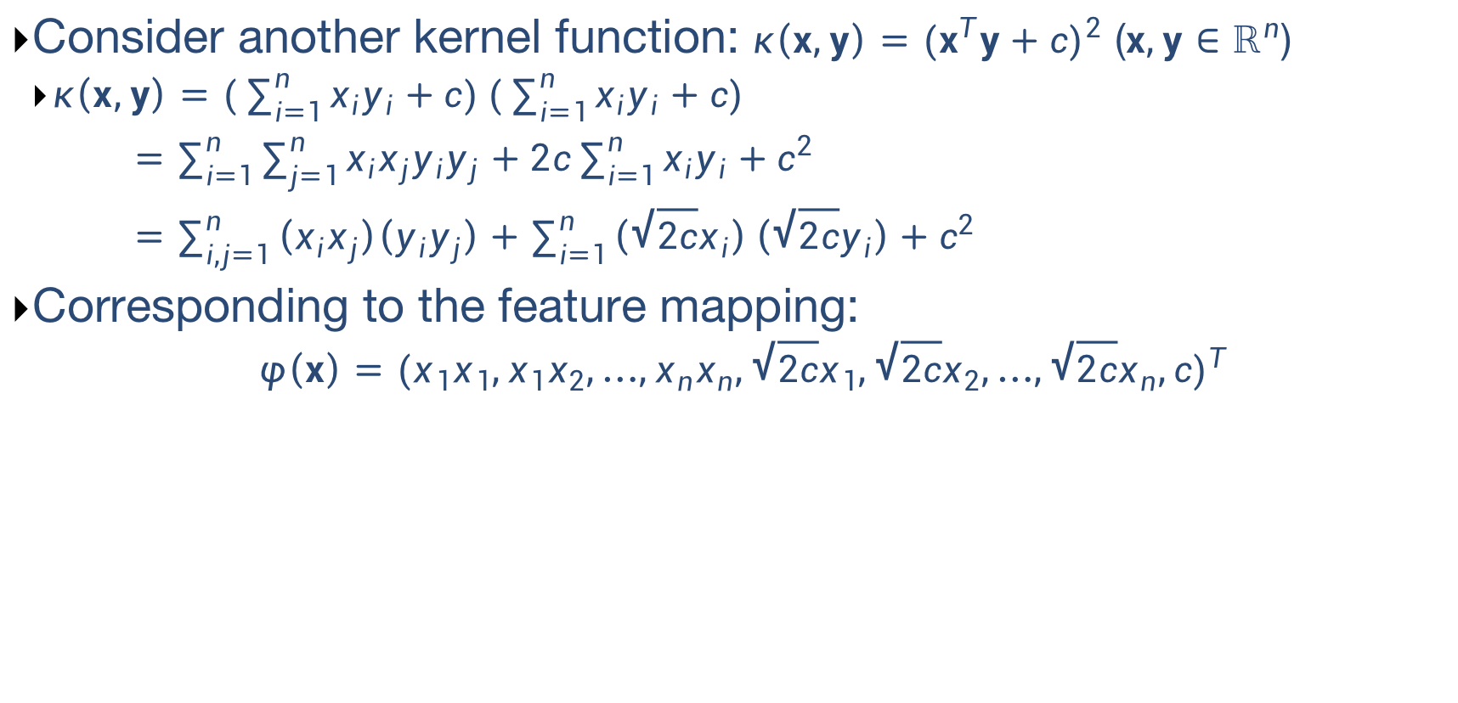
Kernel Functions - Examples
Consider another kernel function: $κ\left(x,y\right)={(x^{T}y+c)}^{2}$ ($x,y∈ℝ^{n}$)
$κ\left(x,y\right)=(\sum_{i=1}^{n}{x_{i}y_{i}+c)}(\sum_{i=1}^{n}{x_{i}y_{i}+c)}$
$=\sum_{i=1}^{n}{\sum_{j=1}^{n}{x_{i}x_{j}y_{i}y_{j}+2c\sum_{i=1}^{n}{x_{i}y_{i}}+c^{2}}}$
$=\sum_{i,j=1}^{n}{\left(x_{i}x_{j}\right)\left(y_{i}y_{j}\right)+\sum_{i=1}^{n}{\left(\sqrt{2c}x_{i}\right)\left(\sqrt{2c}y_{i}\right)+c^{2}}}$
Corresponding to the feature mapping:
$$φ\left(x\right)={(x_{1}x_{1},x_{1}x_{2},…,x_{n}x_{n},\sqrt{2c}x_{1},\sqrt{2c}x_{2},…,\sqrt{2c}x_{n},c)}^{T}$$

Slide 24
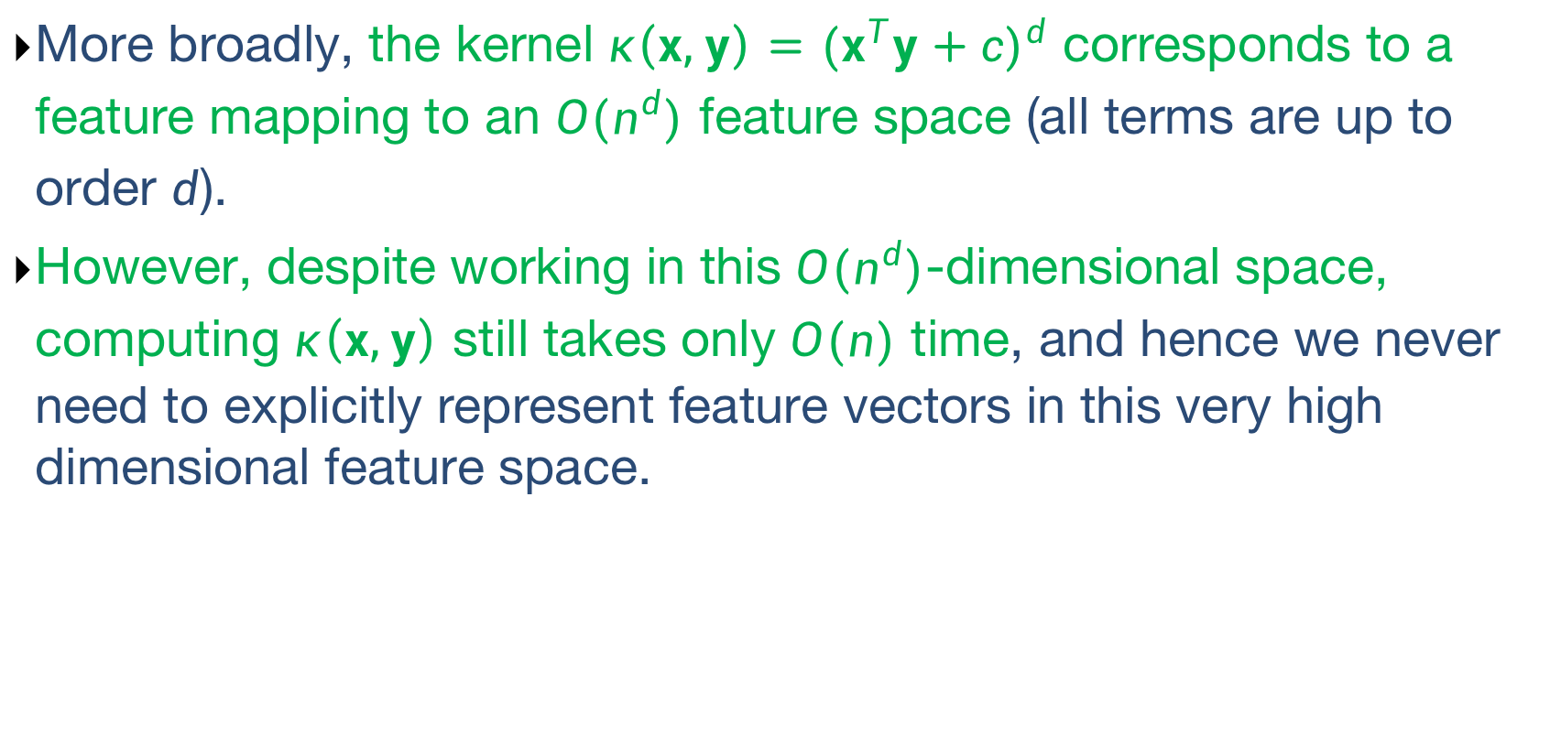
Kernel Functions - Examples
More broadly, the kernel $κ\left(x,y\right)={(x^{T}y+c)}^{d}$ corresponds to a feature mapping to an $O(n^{d})$ feature space (all terms are up to order $d$).
However, despite working in this $O(n^{d})$-dimensional space, computing $κ\left(x,y\right)$ still takes only $O(n)$ time, and hence we never need to explicitly represent feature vectors in this very high dimensional feature space.
Notes:
从n个feature中选取d个，可重复的排列数： n^d
从n个feature中选取d个，可重复的组合数：c(n+d-1,d)

Slide 25
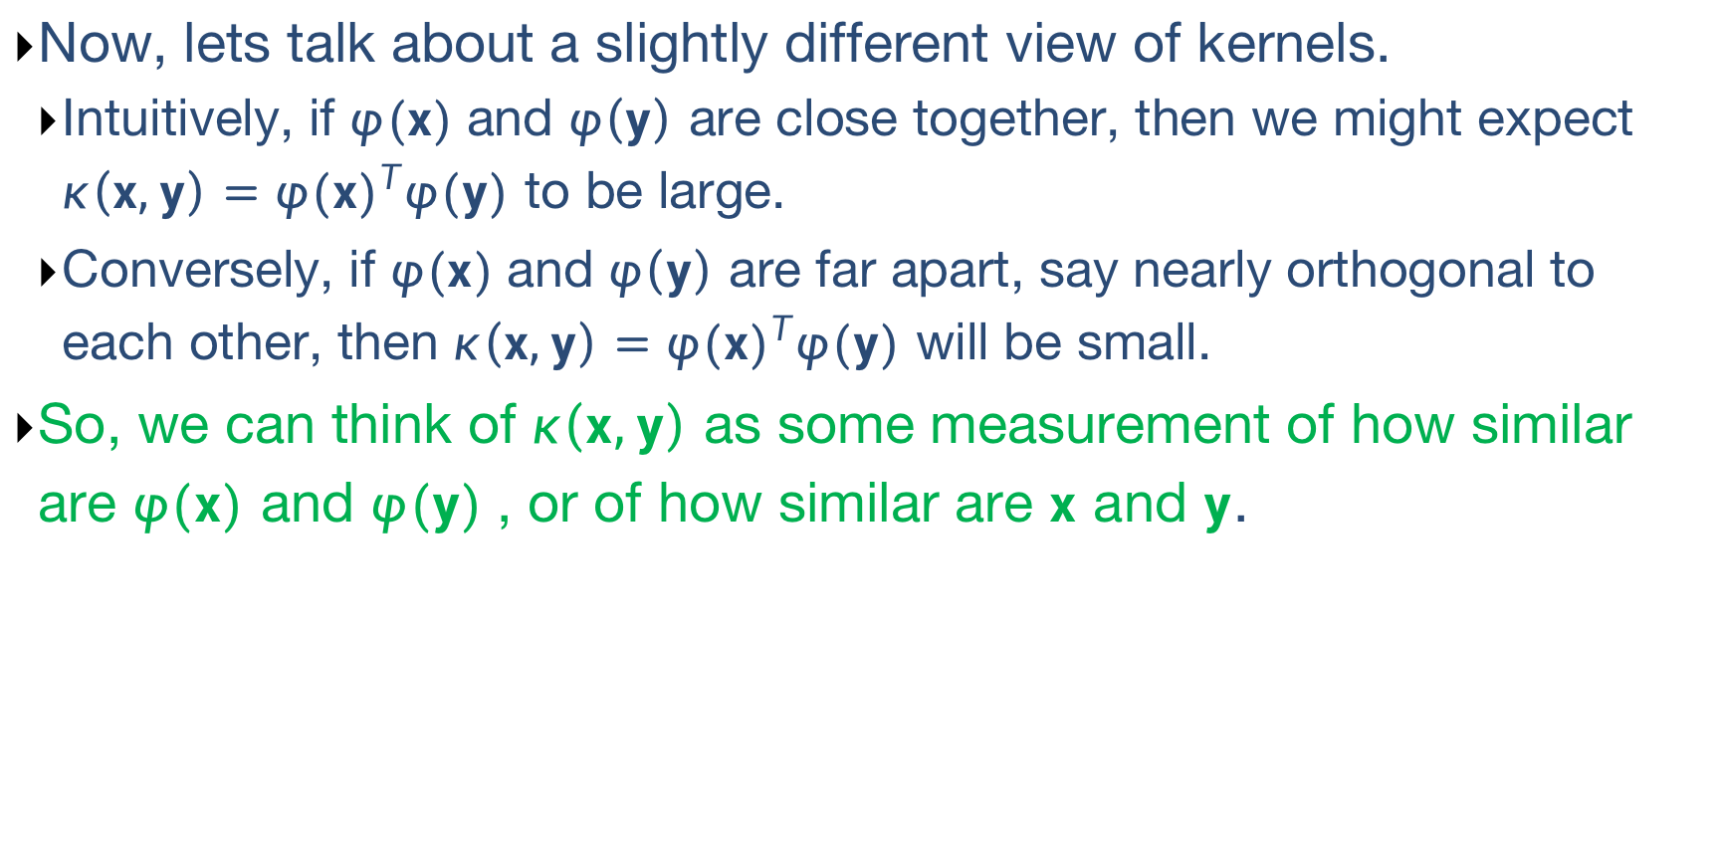
Kernel Trick
Now, lets talk about a slightly different view of kernels.
Intuitively, if $φ(x)$and $φ\left(y\right)$ are close together, then we might expect $κ\left(x,y\right)={φ(x)}^{T}φ(y)$ to be large.
Conversely, if $φ(x)$and $φ\left(y\right)$ are far apart, say nearly orthogonal to each other, then $κ\left(x,y\right)={φ(x)}^{T}φ(y)$ will be small.
So, we can think of $κ\left(x,y\right)$ as some measurement of how similar are $φ(x)$ and $φ(y)$, or of how similar are $x$ and $y$.

Slide 26
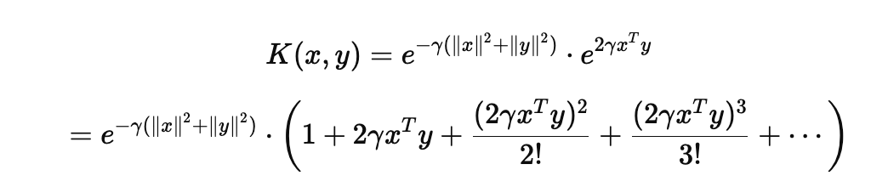
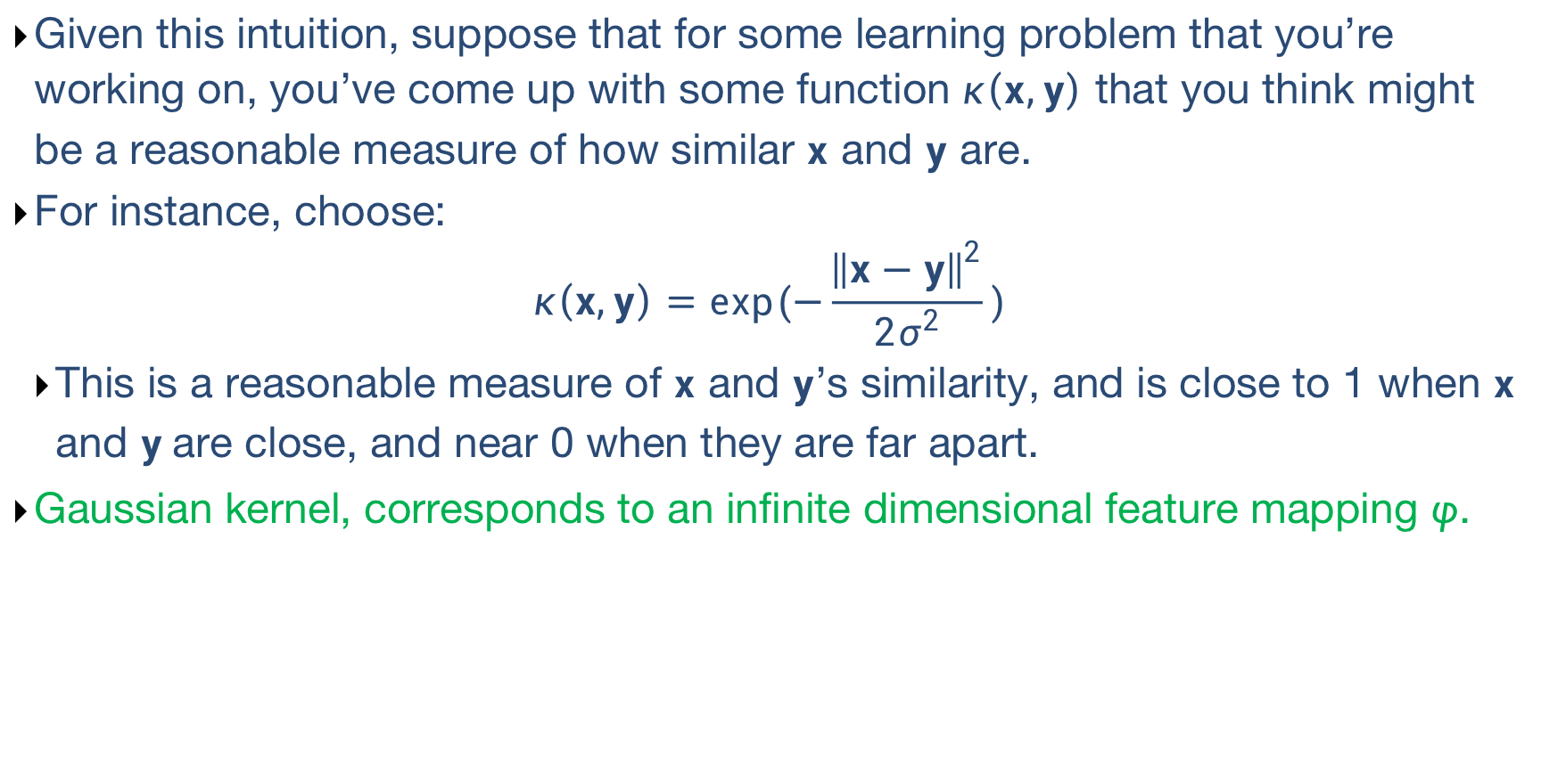
Kernel Trick
Given this intuition, suppose that for some learning problem that you’re working on, you’ve come up with some function $κ\left(x,y\right)$ that you think might be a reasonable measure of how similar $x$ and $y$ are.
For instance, choose:
$$κ\left(x,y\right)=exp(−\frac{{\left\|x−y\right\|}^{2}}{2σ^{2}})$$
This is a reasonable measure of $x$ and $y$’s similarity, and is close to 1 when $x$ and $y$are close, and near 0 when they are far apart.
Gaussian kernel, corresponds to an infinite dimensional feature mapping $φ$.
Infinite feature combinations

Slide 27
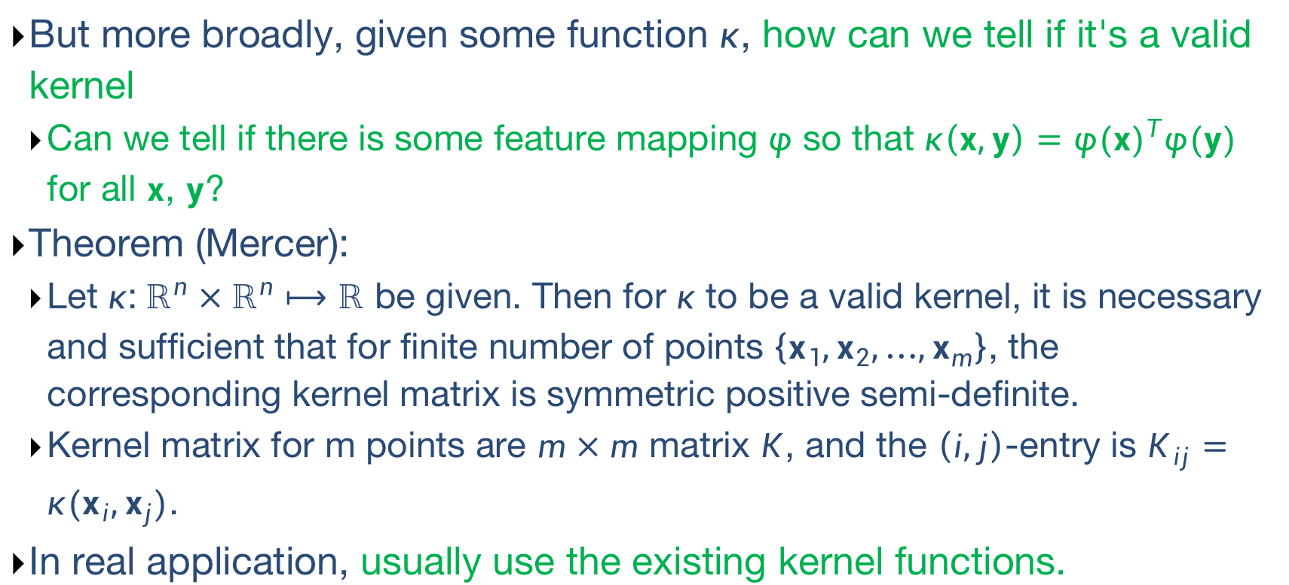
Kernel Trick
But more broadly, given some function $κ$, how can we tell if it's a valid kernel
Can we tell if there is some feature mapping $φ$ so that $κ\left(x,y\right)={φ(x)}^{T}φ(y)$ for all $x$, $y$?
Theorem (Mercer):
Let $κ$:${ ℝ}^{n}×ℝ^{n}⟼$ $ℝ$ be given. Then for $κ$ to be a valid kernel, it is necessary and sufficient that for finite number of points $\left\{x_{1},x_{2},…,x_{m}\right\}$, the corresponding kernel matrix is symmetric positive semi-definite.
Kernel matrix for m points are $m×m$ matrix $K$, and the $\left(i,j\right)$-entry is $K_{ij}=$ $κ(x_{i},x_{j})$.
In real application, usually use the existing kernel functions.

Slide 28
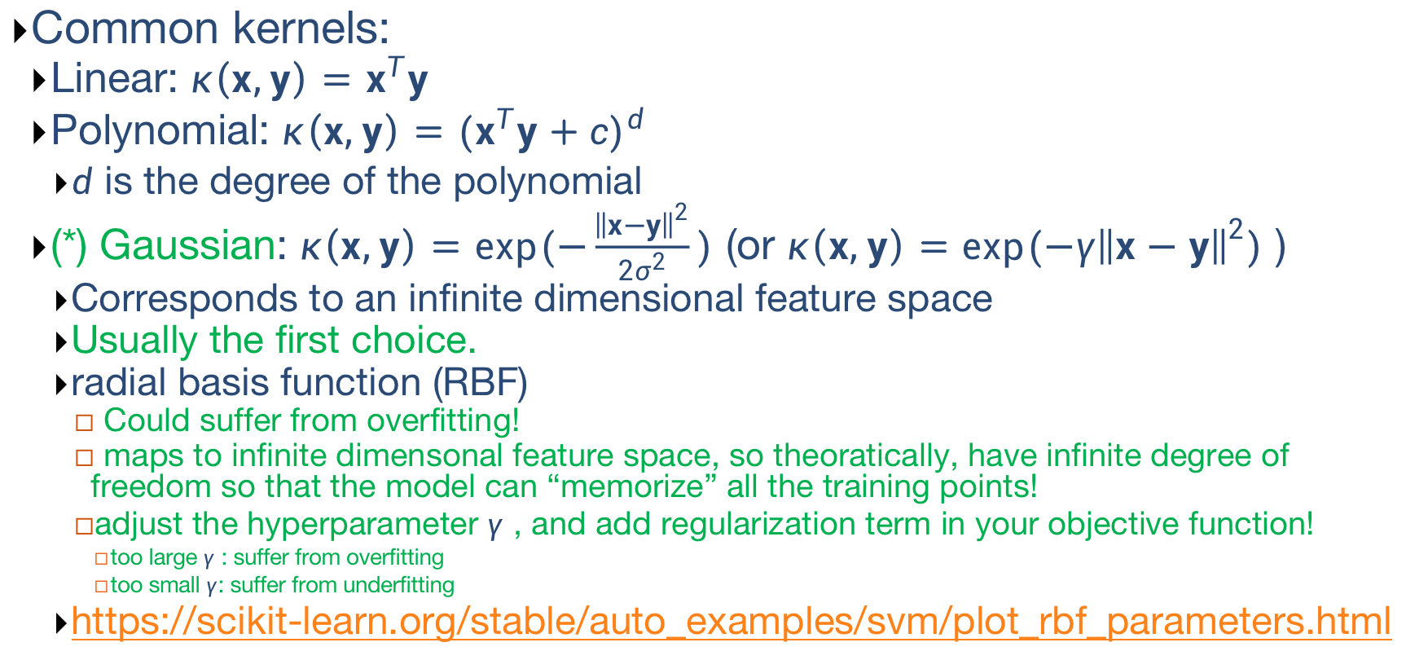
Kernel Functions
Common kernels:
Linear: $κ\left(x,y\right)=x^{T}y$
Polynomial: $κ\left(x,y\right)={(x^{T}y+c)}^{d}$
$d$ is the degree of the polynomial
(*) Gaussian: $κ\left(x,y\right)=exp(−\frac{{\left\|x−y\right\|}^{2}}{2σ^{2}})$ (or $κ\left(x,y\right)=exp(−γ{\left\|x−y\right\|}^{2})$ )
Corresponds to an infinite dimensional feature space
Usually the first choice.
radial basis function (RBF)
Could suffer from overfitting!
maps to infinite dimensonal feature space, so theoratically, have infinite degree of freedom so that the model can “memorize” all the training points!
adjust the hyperparameter $γ$ , and add regularization term in your objective function!
too large $γ$ : suffer from overfitting
too small $γ$: suffer from underfitting
https://scikit-learn.org/stable/auto_examples/svm/plot_rbf_parameters.html
Notes:
Gamma or sigma defines the bandwidth of mapped feature
如果原始数据比较分散，gamma可以小一点。反之，如果原始数据很密集，gamma可以大一点。当然，这不是绝对的，GridSearch

Slide 29
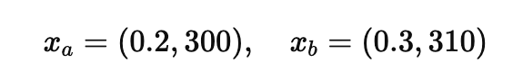
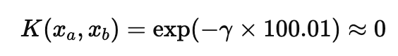
Kernel Functions
Kernel: substitutes the inner product and act as a nonlinear similarity measure
Kernel implicitly defines the feature space
Any algorithm that depends only on inner products can use the kernel trick! e.g.,
SVM, PCA, Ridge Regression, k-means
Perform feature scaling before applying kernel trick.
otherwise, results are dominated by features with large scale, and give you incorrect conclusions.
for example, using RBF kernel:
These two similar data samples are wrongly treated as dissimilar!

Slide 30
How to Choose Kernel Function
Select kernel function based on expert or prior knowledge of the data; if no prior knowledge, try cross validation.
Grid search for hyper-parameter/parameter setting.
https://www.csie.ntu.edu.tw/~cjlin/papers/guide/guide.pdf
Suppose n is the number of features, m is the number of samples
If n is large (compare to m): linear kernel.
If n is small, m is intermediate: RBF kernel
If n is small, m is large: create/add more features and use linear model.
Notes:
Reason: When the number of features is high relative to the number of samples, there is already significant capacity for separating the data in high-dimensional space.

Slide 31
Chapter 3.4: Emsemble Learning

Slide 32
Ensemble Learning
An ensemble learning system is obtained by combining diverse models (henceforth classifiers).
Also known as multi-classifier system, committee-based learning or just ensemble systems.
We use such approach routinely in our daily life by asking the opinions of several experts before making a decision:
Ask the opinions of several doctors before agreeing to a medical procedure;
Read user reviews before purchasing an item (particularly big ticket items);
Evaluate future employees by checking their references.

Slide 33
Ensemble Learning
An ensemble contains a number of learners which are usually called base learners. The generalization ability of an ensemble is usually much stronger than that of base learners.
Actually, ensemble learning is appealing because that it is able to boost weak learners which are slightly better than random guess to strong learners which can make very accurate predictions.
Base learners are also referred as weak learners.

Slide 34
Ensemble Learning
Base learners are usually generated from training data by a base learning algorithm which can be
decision tree
neural network
or other kinds of machine learning algorithms.
Most ensemble methods use a single base learning algorithm to produce homogeneous base learners.
Also some methods which use multiple learning algorithms to produce heterogeneous learners.
No single base learning algorithm and thus, some people prefer calling the learners individual learners or component learners.

Slide 35
Ensemble Construction
Typically, an ensemble is constructed in two steps.
First, a number of base learners are produced, which can be generated in a parallel style or in a sequential style where the generation of a base learner has influence on the generation of subsequent learners.
Then, the base learners are combined to use, where among the most popular combination schemes are majority voting for classification and weighted averaging for regression.

Slide 36
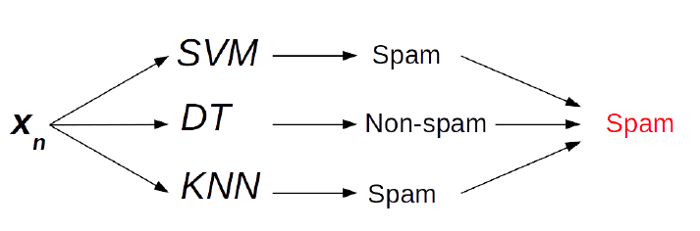
Ensembles Strategies
Voting or averaging of prediction of multiple pre-trained models.

Slide 37
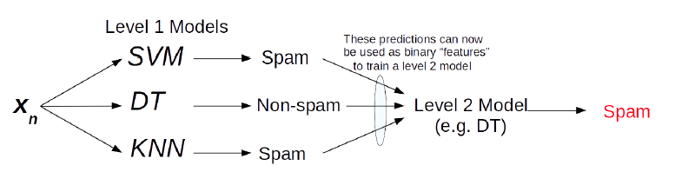
Ensembles Strategies
Stacking: use predictions of multiple models as “features” to train a new model and use the new model to make predictions on test data.

Slide 38
Ensemble: Another Strategy
Instead of training different models on same data, train same model multiple times on different data sets , and "combine" these "different" models.
Use some simple/weak model as the base model/learning algorithm.
How to generate different data sets? (In practices, we only have one data set at training time.)

Slide 39
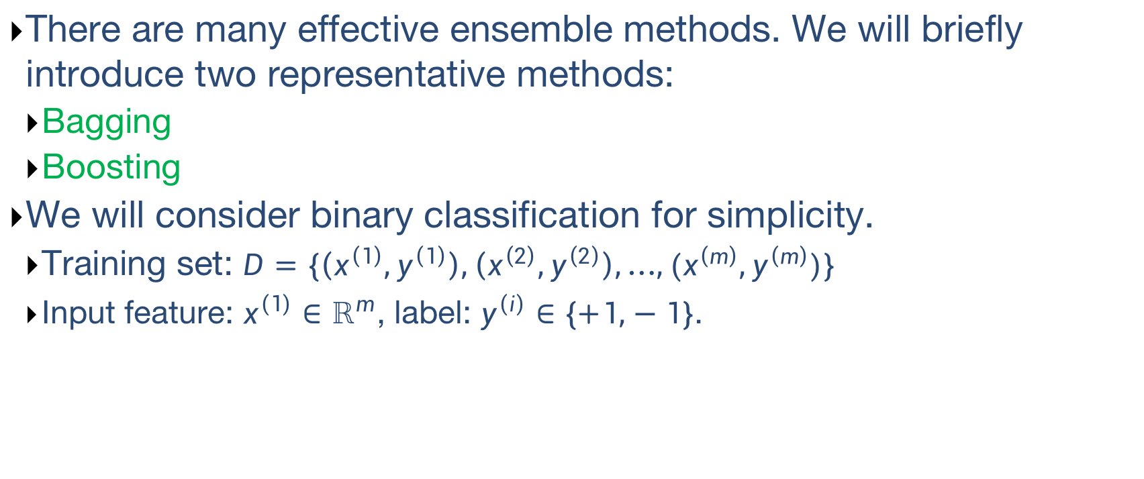
Ensemble Methods
There are many effective ensemble methods. We will briefly introduce two representative methods:
Bagging
Boosting
We will consider binary classification for simplicity.
Training set: $D=\{\left(x^{\left(1\right)},y^{\left(1\right)}\right),\left(x^{\left(2\right)},y^{\left(2\right)}\right),…,(x^{\left(m\right)},y^{\left(m\right)})\}$
Input feature: $x^{\left(1\right)}∈ℝ^{m}$, label: $y^{\left(i\right)}∈\{+1,−1\}$.

Slide 40
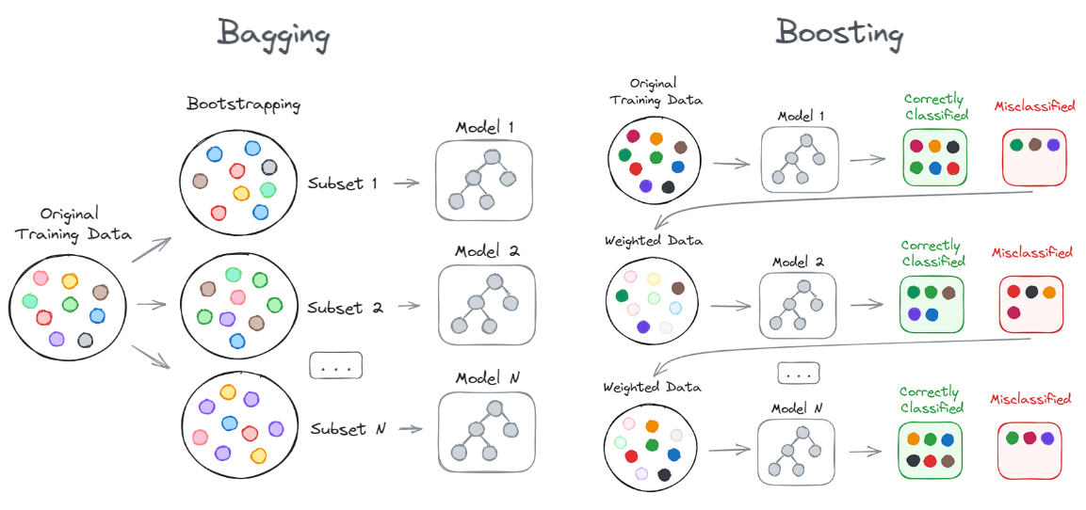
Ensemble Methods
Bagging
Boosting

Slide 41
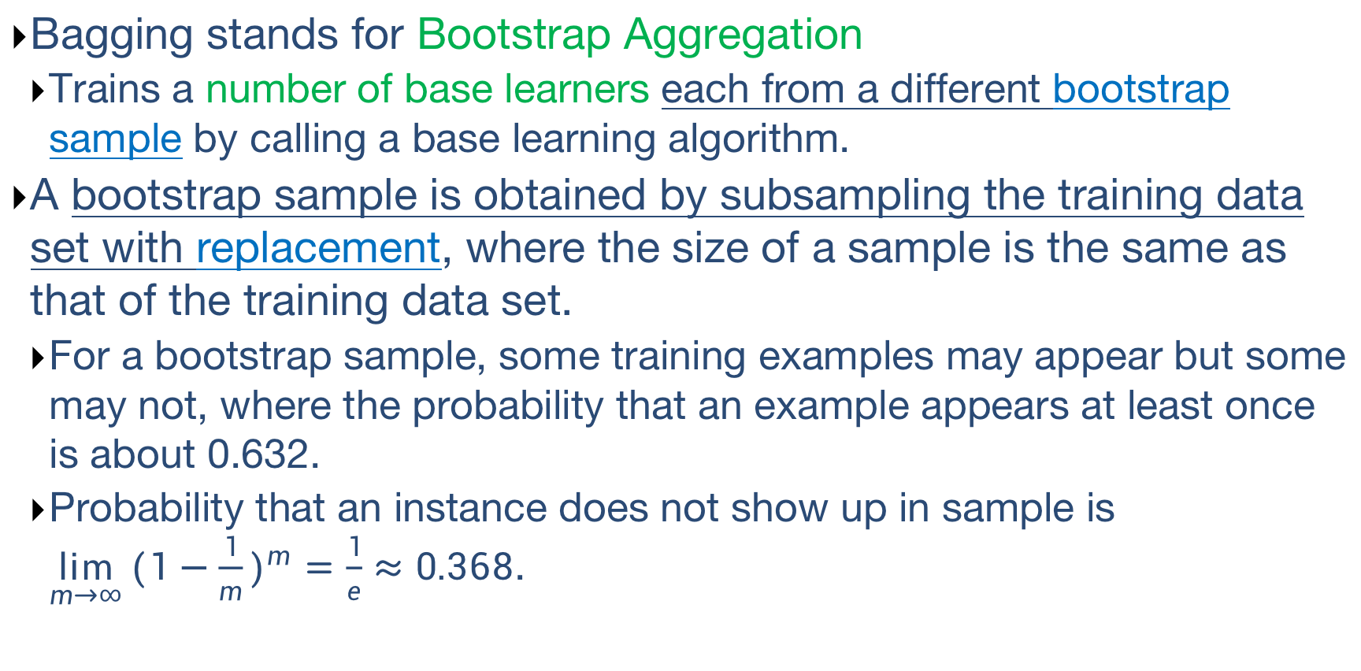
Bagging
Bagging stands for Bootstrap Aggregation
Trains a number of base learners each from a different bootstrap sample by calling a base learning algorithm.
A bootstrap sample is obtained by subsampling the training data set with replacement, where the size of a sample is the same as that of the training data set.
For a bootstrap sample, some training examples may appear but some may not, where the probability that an example appears at least once is about 0.632.
Probability that an instance does not show up in sample is $\lim_{m→∞}{{(1−\frac{1}{m})}^{m}=\frac{1}{e}≈0.368}$.

Slide 42
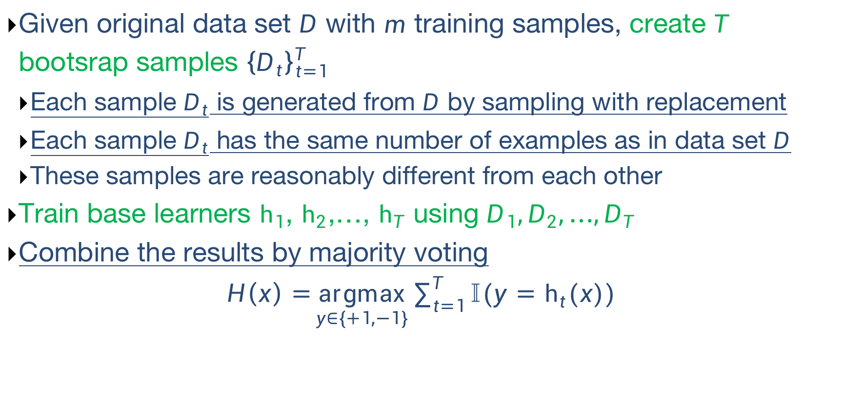
Bagging
Given original data set $D$ with $m$ training samples, create $T$ bootsrap samples ${\left\{D_{t}\right\}}_{t=1}^{T}$
Each sample $D_{t}$ is generated from $D$ by sampling with replacement
Each sample $D_{t}$ has the same number of examples as in data set $D$
These samples are reasonably different from each other
Train base learners $h_{1}$, $h_{2}$,…, $h_{T}$ using $D_{1},D_{2},…,D_{T}$
Combine the results by majority voting
$H\left(x\right)=\underset{y∈\{+1,−1\}}{argmax}{\sum_{t=1}^{T}{𝕀(y=h_{t}(x))}}$

Slide 43
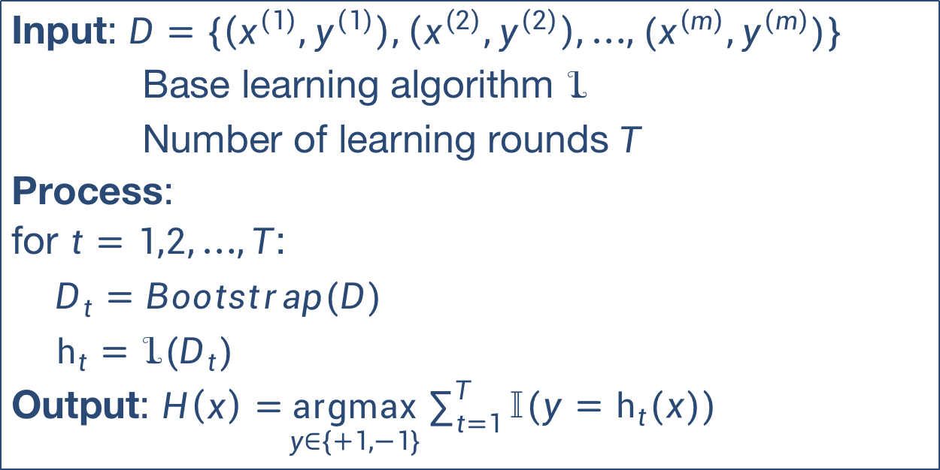
Bagging Algorithm
Input: $D=\{\left(x^{\left(1\right)},y^{\left(1\right)}\right),\left(x^{\left(2\right)},y^{\left(2\right)}\right),…,(x^{\left(m\right)},y^{\left(m\right)})\}$
Base learning algorithm $ℒ$
Number of learning rounds $T$
Process:
for $t=1,2,…,T$:
$D_{t}=Bootstrap(D)$
$h_{t}=$ $ℒ(D_{t})$
Output: $H\left(x\right)=\underset{y∈\{+1,−1\}}{argmax}{\sum_{t=1}^{T}{𝕀(y=h_{t}(x))}}$

Slide 44
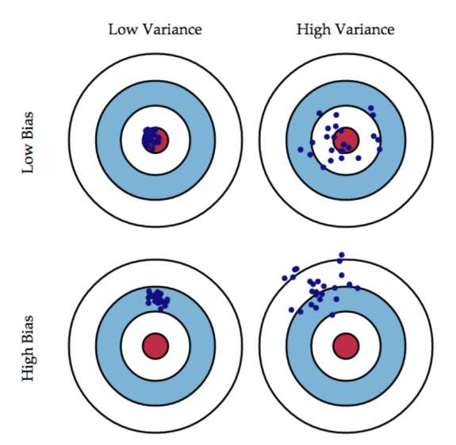
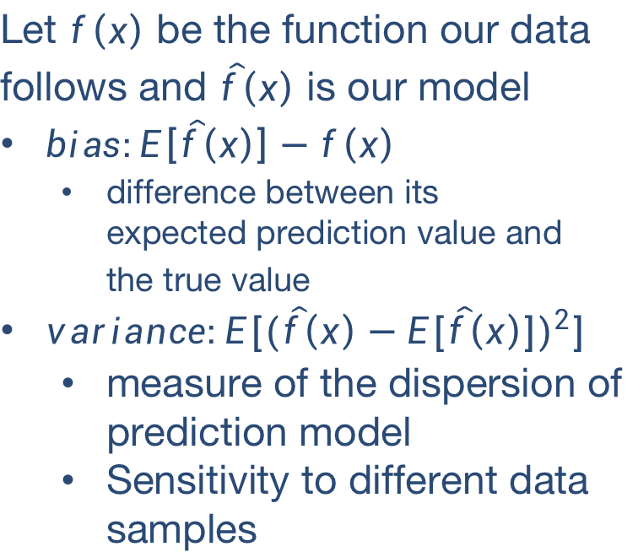
Bias and Variance
Let $f\left(x\right)$ be the function our data follows and $\hat{f}\left(x\right)$ is our model
$bias:E\left[\hat{f}\left(x\right)\right]−f\left(x\right)$
difference between its expected prediction value and the true value
$variance:E[{(\hat{f}\left(x\right)−E[\hat{f}\left(x\right)])}^{2}]$
measure of the dispersion of prediction model
Sensitivity to different data samples

Slide 45
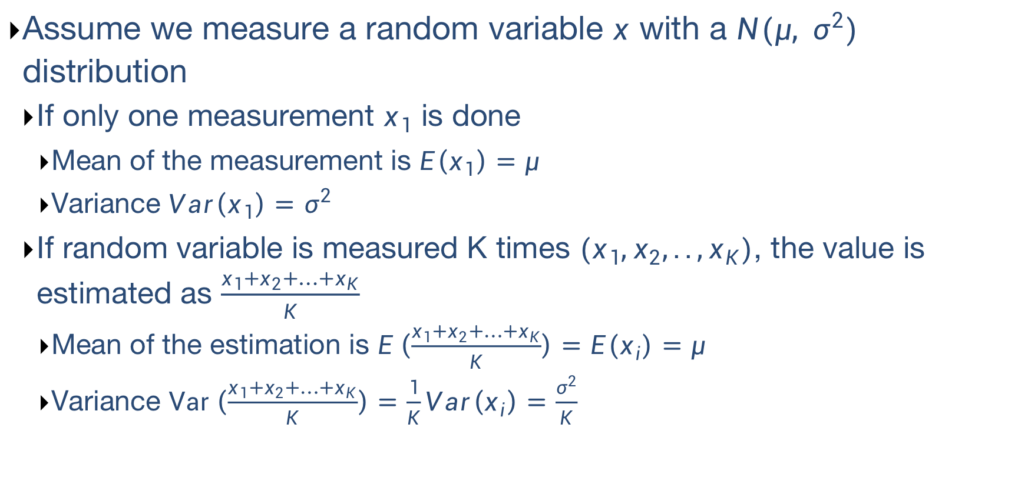
Averaging Reduce Variance
Assume we measure a random variable $x$ with a $N(μ, σ^{2})$ distribution
If only one measurement $x_{1}$ is done
Mean of the measurement is $E\left(x_{1}\right)=μ$
Variance $Var\left(x_{1}\right)=σ^{2}$
If random variable is measured K times $(x_{1},x_{2},..,x_{K})$, the value is estimated as $\frac{x_{1}+x_{2}+…+x_{K}}{K}$
Mean of the estimation is $E\left(\frac{x_{1}+x_{2}+…+x_{K}}{K}\right)=E\left(x_{i}\right)=μ$
Variance $Var\left(\frac{x_{1}+x_{2}+…+x_{K}}{K}\right)=\frac{1}{K}Var\left(x_{i}\right)=\frac{σ^{2}}{K}$

Slide 46
When Bagging Helps?
Observe: bagging is a kind of average
Main property of bagging:
Bagging decreases variance of the base model without changing the bias.
Bagging typically helps
When applied with an over-fitted base model. High dependency on actual training data.
Bagging does not help much
High bias. When the base model is robust to the changes in the training data.

Slide 47
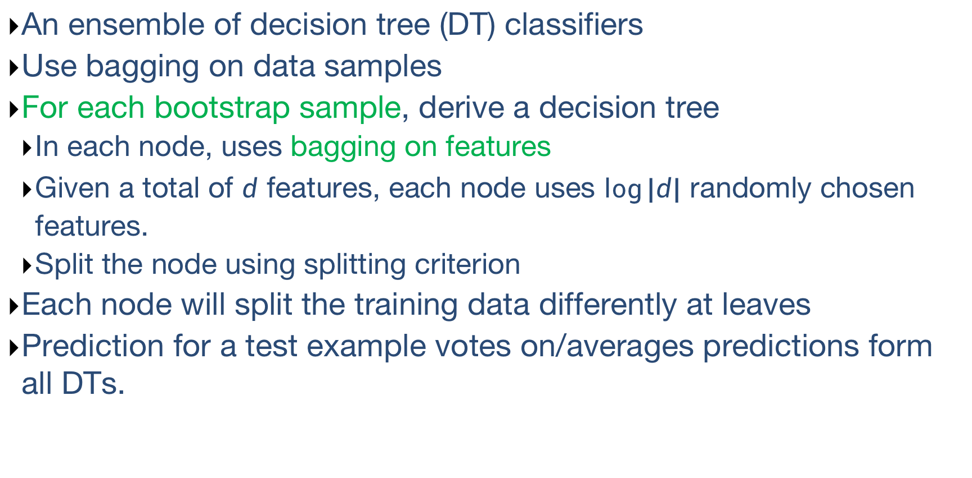
Random Forest
An ensemble of decision tree (DT) classifiers
Use bagging on data samples
For each bootstrap sample, derive a decision tree
In each node, uses bagging on features
Given a total of $d$ features, each node uses $\log{|d|}$ randomly chosen features.
Split the node using splitting criterion
Each node will split the training data differently at leaves
Prediction for a test example votes on/averages predictions form all DTs.

Slide 48
Boosting
Basic idea:
Take a weak learning algorithm (slightly better than random)
Turn it into an awesome one by making it focus on difficult samples
Most boosting algorithms follows these steps:
Train a weak model on some training data
Compute the error of the model on each training sample
Give higher importance to examples on which the model made mistakes
Re-train the model using “importance weighted” training examples
Go back to step2.
Boosting is in fact a family of algorithms since there are many variants. Here, the most famous algorithm, AdaBoost is considered as an example.

Slide 49
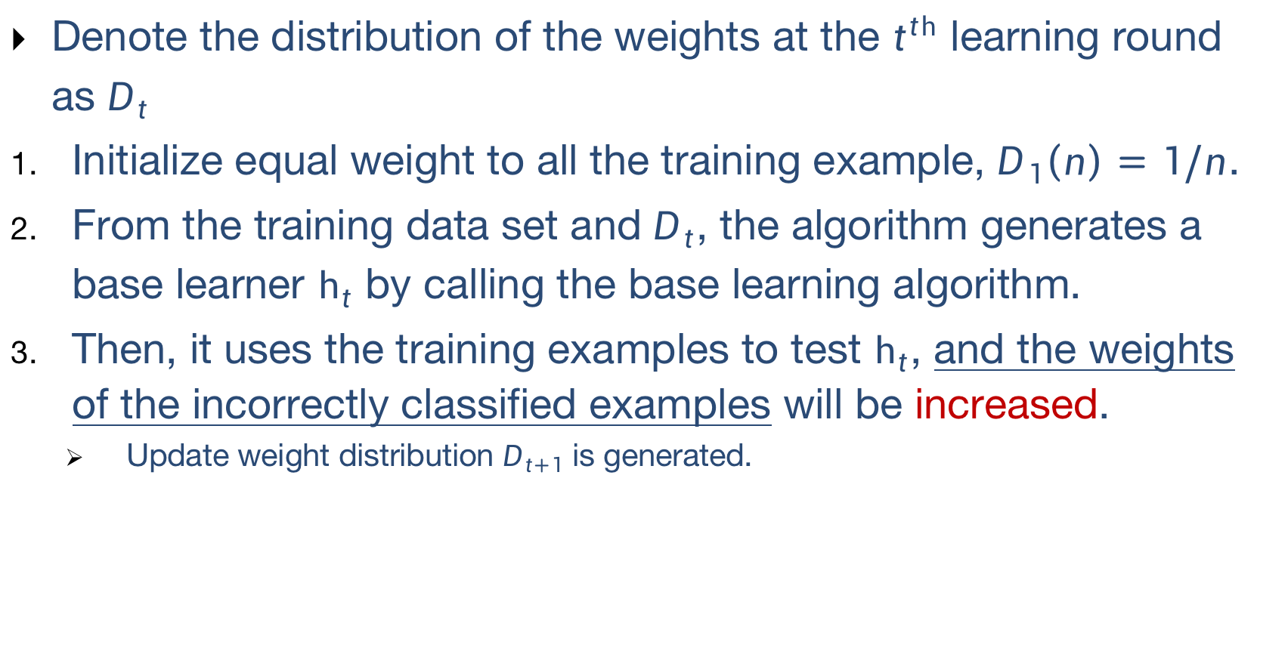
AdaBoost
Denote the distribution of the weights at the $t^{th}$ learning round as $D_{t}$
Initialize equal weight to all the training example, $D_{1}\left(n\right)=1/n$.
From the training data set and $D_{t}$, the algorithm generates a base learner $h_{t}$ by calling the base learning algorithm.
Then, it uses the training examples to test $h_{t}$, and the weights of the incorrectly classified examples will be increased.
Update weight distribution $D_{t+1}$ is generated.

Slide 50
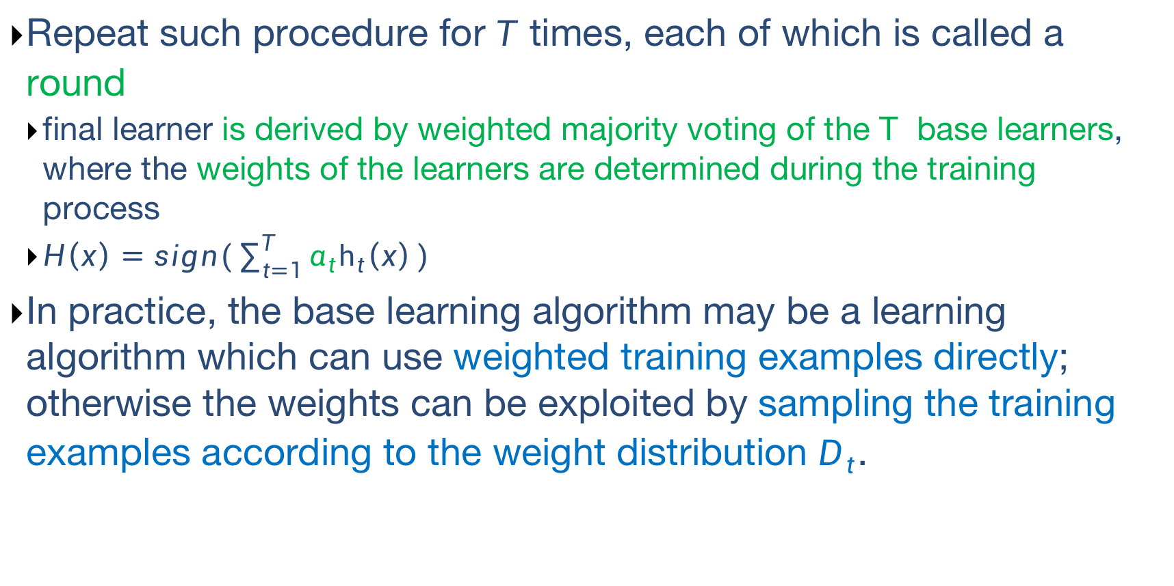
AdaBoost
Repeat such procedure for $T$ times, each of which is called a round
final learner is derived by weighted majority voting of the T base learners, where the weights of the learners are determined during the training process
$H\left(x\right)=sign(\sum_{t=1}^{T}{α_{t}h_{t}\left(x\right)})$
In practice, the base learning algorithm may be a learning algorithm which can use weighted training examples directly; otherwise the weights can be exploited by sampling the training examples according to the weight distribution $D_{t}$.

Slide 51
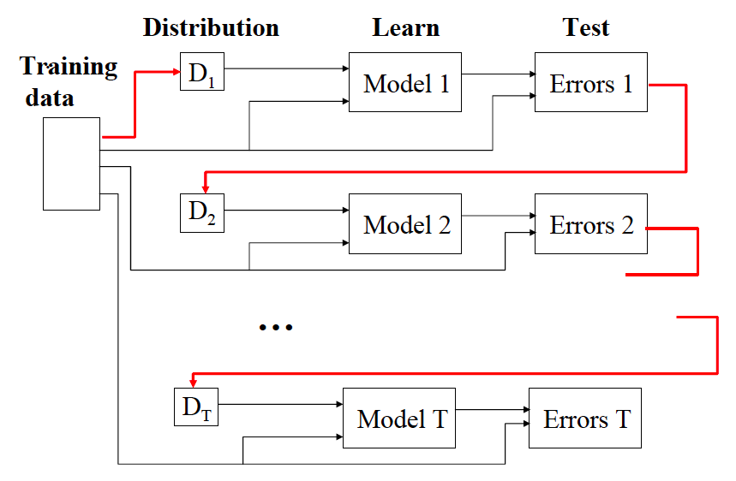
AdaBoost

Slide 52
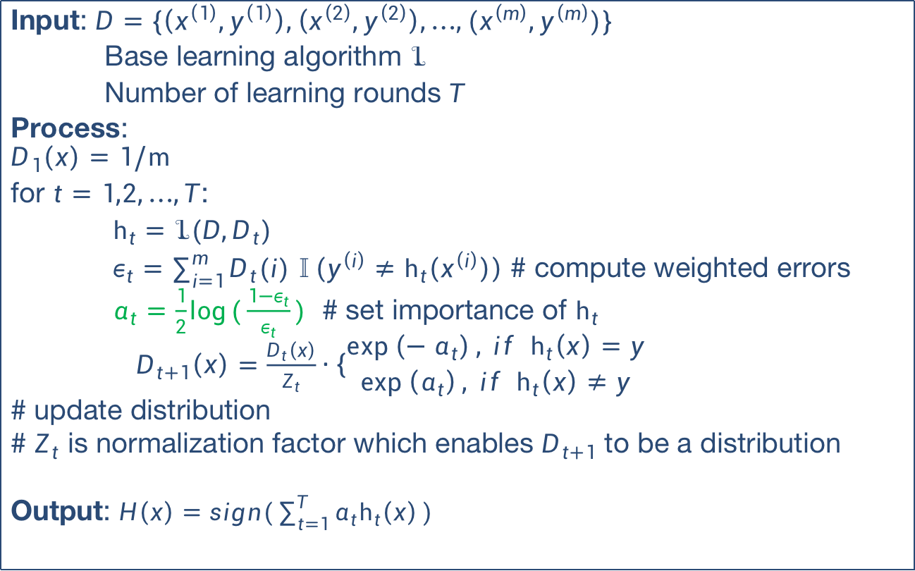
AdaBoost Algorithm
Input: $D=\{\left(x^{\left(1\right)},y^{\left(1\right)}\right),\left(x^{\left(2\right)},y^{\left(2\right)}\right),…,(x^{\left(m\right)},y^{\left(m\right)})\}$
Base learning algorithm $ℒ$
Number of learning rounds $T$
Process:
$$D_{1}\left(x\right)=1/m$$
for $t=1,2,…,T$:
$h_{t}=$ $ℒ(D,D_{t})$
$ε_{t}=\sum_{i=1}^{m}{D_{t}(i)}$ $𝕀\left(y^{\left(i\right)}≠h_{t}\left(x^{\left(i\right)}\right)\right)$ # compute weighted errors
$α_{t}=\frac{1}{2}\log{(\frac{1−ε_{t}}{ε_{t}})}$ # set importance of $h_{t}$
$D_{t+1}\left(x\right)=\frac{D_{t}\left(x\right)}{Z_{t}}∙\left\{\begin{aligned}\exp\left(−α_{t}\right), if h_{t}\left(x\right)=y \\ \exp\left(α_{t}\right), if h_{t}\left(x\right)≠y\end{aligned}\right.$
# update distribution
# $Z_{t}$ is normalization factor which enables $D_{t+1}$ to be a distribution
Output: $H\left(x\right)=sign(\sum_{t=1}^{T}{α_{t}h_{t}\left(x\right)})$

Slide 53
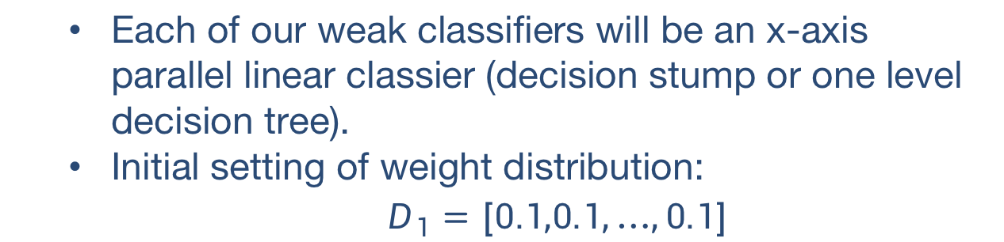

AdaBoost Examples
Consider binary classification with 10 training examples
ID | 1 | 2 | 3 | 4 | 5 | 6 | 7 | 8 | 9 | 10
$$x$$ | 0 | 1 | 2 | 3 | 4 | 5 | 6 | 7 | 8 | 9
$$y$$ | 1 | 1 | 1 | -1 | -1 | -1 | 1 | 1 | 1 | -1
Each of our weak classifiers will be an x-axis parallel linear classier (decision stump or one level decision tree).
Initial setting of weight distribution:
$$D_{1}=[0.1,0.1,…,0.1]$$

Slide 54


AdaBoost Examples
ID | 1 | 2 | 3 | 4 | 5 | 6 | 7 | 8 | 9 | 10
$$x$$ | 0 | 1 | 2 | 3 | 4 | 5 | 6 | 7 | 8 | 9
$$y$$ | 1 | 1 | 1 | -1 | -1 | -1 | 1 | 1 | 1 | -1
Round 1: classifier $h_{1}\left(x\right)=\left\{\begin{aligned}1, if x<2.5 \\ −1, if x>2.5\end{aligned}\right.$
Error:$ε_{1}=0.1∗3=0.3$
Importance: $α_{1}=\frac{1}{2}\log{(\frac{1−ε_{1}}{ε_{1}})}$=0.4236
Update weight distribution:
$D_{2}\left(i\right)=\frac{0.1}{z}∗\exp\left(−0.4236\right)=0.0715 for i=1,2,3,4,5,6,10$
$D_{2}\left(i\right)=\frac{0.1}{z}∗\exp\left(0.4236\right)=0.1666 for i=7,8,9$

Slide 55


AdaBoost Examples
ID | 1 | 2 | 3 | 4 | 5 | 6 | 7 | 8 | 9 | 10
$$x$$ | 0 | 1 | 2 | 3 | 4 | 5 | 6 | 7 | 8 | 9
$$y$$ | 1 | 1 | 1 | -1 | -1 | -1 | 1 | 1 | 1 | -1
Round 2:
$D_{2}=[0.0715,0.0715,0.0715,0.0715,0.0715,0.0715,0.1666,0.1666,0.1666,0.0715]$
classifier $h_{2}\left(x\right)=\left\{\begin{aligned}1, if x<8.5 \\ −1, if x>8.5\end{aligned}\right.$
Error:$ε_{2}=0.0715∗3=0.2145$
Importance: $α_{2}=\frac{1}{2}\log{(\frac{1−ε_{2}}{ε_{2}})}$=0.649
Update weight distribution:
$D_{3}=[ 0.045,0.045,0.045,0.167,0.167,0.167,0.106,0.106,0.106,0.045]$

Slide 56

AdaBoost Examples
ID | 1 | 2 | 3 | 4 | 5 | 6 | 7 | 8 | 9 | 10
$$x$$ | 0 | 1 | 2 | 3 | 4 | 5 | 6 | 7 | 8 | 9
$$y$$ | 1 | 1 | 1 | -1 | -1 | -1 | 1 | 1 | 1 | -1
Round 3:
$D_{3}=[ 0.045,0.045,0.045,0.167,0.167,0.167,0.106,0.106,0.106,0.045]$
classifier $h_{3}\left(x\right)=\left\{\begin{aligned}−1, if x<5.5 \\ 1, if x>5.5\end{aligned}\right.$
Error:$ε_{3}=0.045∗4=0.18$
Importance: $α_{3}=\frac{1}{2}\log{(\frac{1−ε_{3}}{ε_{3}})}$=0.758
Update weight distribution:
$D_{4}=[ 0.125,0.125,0.125,0.102,0.102,0.102,0.065,0. 065,0.065,0.125]$

Slide 57


AdaBoost Examples
ID | 1 | 2 | 3 | 4 | 5 | 6 | 7 | 8 | 9 | 10
$$x$$ | 0 | 1 | 2 | 3 | 4 | 5 | 6 | 7 | 8 | 9
$$y$$ | 1 | 1 | 1 | -1 | -1 | -1 | 1 | 1 | 1 | -1
$$H\left(x\right)$$ | 1 | 1 | 1 | -1 | -1 | -1 | 1 | 1 | 1 | -1
Output classifier after three rounds:
$h_{1}\left(x\right)=\left\{\begin{aligned}1, if x<2.5 \\ −1, if x>2.5\end{aligned}\right.$, $h_{2}\left(x\right)=\left\{\begin{aligned}1, if x<8.5 \\ −1, if x>8.5\end{aligned}\right.$,
$h_{3}\left(x\right)=\left\{\begin{aligned}−1, if x<5.5 \\ 1, if x>5.5\end{aligned}\right.$
$H\left(x\right)=sign(0.4236∗h_{1}\left(x\right)+0.649∗h_{2}\left(x\right)+0.758∗h_{3}\left(x\right))$
Error: 0.
Multiple weak, linear classifiers combined to give a strong, nonlinear classier.

Slide 58

Boosting
Boosting algorithms can be shown to be minimizing an exponential loss function:
$l_{exp}\left(H | D\right)=\sum_{i=1}^{m}{\exp\left\{−y^{\left(i\right)}H\left(x^{\left(i\right)}\right)\right\} }$
where $H\left(x\right)= \sum_{t=1}^{T}{α_{t}h_{t}\left(x\right)}$
For proof, refer to 14.3 boosting in “Pattern Recognition and Machine Learning”.
Boosting will sequentially minimize the loss function, will reduce the bias.

Slide 59
Bagging vs Boosting
No clear winner, usually depends on the data
Bagging is computationally more efficient than boosting
Bagging can train the M models in parallel, boosting cannot.
Both reduce variance (and overfitting) by combining different models.
The resulting model has higher stability as compared to individual ones.
Bagging usually cannot reduce the bias, boosting can.
Bagging usually performs better than boosting if we do not have a high bias and only want to reduce variance
Higher correlation between models.

